Slide 1
LOBBYING & ADVOCATING
FOR YOUR YSB
THE ADVANCEMENT AND PROTECTION OF CYSA' S INTERESTS.
JAY ARONSON
CONNSENSUS GOVERNMENT
CONSULTING

Slide 2
ABOUT ME
1988 - Began my political career as the Assistant Clerk of the CT General Assembly' s Government Administration & Elections
Committee and held senior level caucus positions in the House Republican Office until 1995 .
1995 - Began Lobbying as a member of the Murtha Cullina Richter & Pinney Government Affairs Group.
1999 - Joined CT Hospital Association as Assistant VP of Government Relations.
2002 - Joined Connsensus Government Consulting. Have enjoyed major lobbying successes over the past 20 years including securing significant state funding for YSBs.
Key Practice Areas: Children’ s/ youths issues, children’ s health
issues, environmental health issues, recycling and conservation
issues, Medicaid funding,youth summer camps, and entertainment and artist promotion issues.

Slide 3
WHAT IS LOBBYING?
Lobbying is defined as the process of advocating for and influencing public and government policy. The practice of which is considered so essential to the proper function of all levels of government that it is specifically protected by the first amendment of the United States Constitution.
WHAT I DO FOR CYSA & YOUR YSB
For nearly 25 years as CYSA’s Lobbyist, I have and continue to, work with the CYSA Board, its Advocacy Committee, and the Executive Director to promote key issues and initiatives affecting YSBs before the Connecticut Legislature and State Agencies of cognizance.

Slide 4
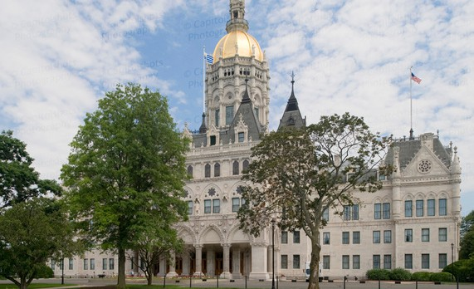
CONNECTICUT STATE
LEGISLATURE
House of Representatives
151 Members representing approx. 23,000 people in each district:
Serve 2 year terms.
Senate
36 Members representing approx. 100,000 people each district
Serve 2 year terms.
2023-24: 98 Democrats & 53 Republicans 2023-24: 24 Democrats & 12 Republicans

Slide 5
Key Dates
NOVEMBER 5 , 2024
All 151 seats in the House of Reps. and 36 state Senate will be up for
( re) election.
January 9 , 2025
Opening day of the 2025 Legislative Session.
June 4 , 2025
Closing day of the 2025 Legislative Session.

Slide 6
The Connecticut General Assembly is a “Part time Legislature” which means most Members have other jobs.
LEGISLATIVE
SESSION DATES
In even number years, i.e. 2024, the Legislature meets from February to May
("Short Session")
In odd number years, i.e. 2025, the Legislature meets from January to June
("Long Session")

Slide 7
How a Bill
Becomes a Law
CONCEPTS
Introduced to the Committee of cognizance and crafted into bills.
PUBLIC HEARING
Bills are raised for public hearing. Oral and written testimony is accepted.
COMMITTEE VOTE
After a public hearing, bills are eligible for a
committee vote. Bills acted on favorably are sent to the Chamber of origin: House or Senate.
SENATE/ HOUSE VOTES
Once approved by both Chambers for final action, the bill is sent to the Governor for his signature.

Slide 8
BUDGETARY PROCESS
The Governor gives his budget address in
early February. Once his budget is presented,
I work to promote the interests of YSBs
before the Members of the Appropriations Committee. This Committee breaks down
the Governor' s budget, proposes important changes and negotiates the f inal budget
with Leadership. A f inal budget is then
voted on by each Chamber prior to end of session.

Slide 9
HOW TO GET INVOLVED
Legislators need to hear from you!
Get to know your legislators. Invite them to visit your YSB. Help them
understand what you do.
Support your Chapter' s
Legislative Meeting.
Invite, Attend, Engage
Offer testimony on issues
impacting you, this can be in support or in
opposition.

Slide 10
COMMUNICATION IS KEY
In the end, while I may be the face of YSBs and CYSA at the state Capitol, your one- on-one relationships with YOUR Legislators is equally important, if not more so!
YOU make a difference!
JAY ARONSON
JARONSON@SANDLERMARA. COM

