Slide 1
YSB 101
Restorative Justice:
A Primer

Slide 2
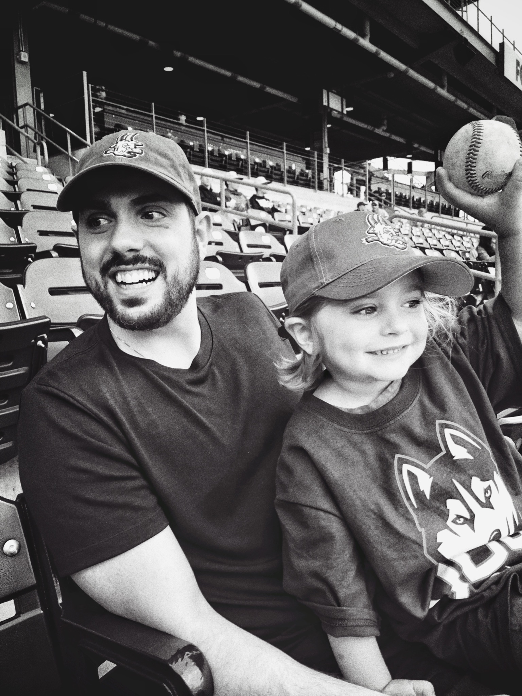
Justin Carbonella
Father x 2, husband, son, brother, NY native, Middletown homer, UConn grad x2, Yankee fan/baseball lover, mentor, trainer, and
Youth Services Director for City of Middletown

Slide 3
Overview
Learning objectives:
Discuss what Restorative Justice is and its foundations and values
Understand how circles/RJ can be used for both connection and addressing conflict
Connect that work to what we know about the brain/trauma/stress
Notes:
Goals for tonight, give you tools to use at your camps this summer, we will be also coming to each site to give added support
Our ability to see you improves our ability to connect with you
Do whatever makes you most comfortable
Can ask questions throughout

Slide 4
—Dr. Cornel West
What is Restorative Justice?
An ancient and innovative framework that centers relationships in both building community and repairing harm within it.
A lens from which to see the world.
A way to do things on purpose/No happy accidents.
“Justice is what love looks like in public.”
Notes:
Seems like a buzzword, or fad but it is actually how to be in right relationship to ourselves, our communities, and our world
Normalizes and embraces conflict in a community and allows for authenticity and deeper connections to be made
Conflict is natural and can give us information
Seeing conflict as an opportunity for innovation and connection changes our interactions
Starts with reimagining what the goal is. Instead of trying to get to “I told you so”, we need to focus on healing harm, mitigating future harm and building community.
Restorative justice highlights need for community to hold each other accountable without pushing each other out of community.
What led to the issue? How do we prevent it from happening again? How do we meet people’s needs?
Lens of strengths over weaknesses
Promotes healing and accountability
Constantly experimenting
Small communities (like summer camps) have the power to change the way the world sees relationships/justice today

Slide 5
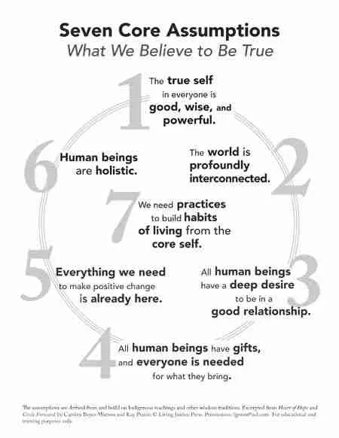

Slide 6
Beloved Community
Beloved community includes ALL people.
“The end is the creation of the beloved community. It is this type of spirit and this type of love that can transform opposers into friends… it is agape which is understanding goodwill for all men. It is an overflowing love which seeks nothing in return.”
- Martin Luther King, Jr.
“When my brothers try to draw a circle to exclude me, I shall draw a larger circle to include them.” - Pauli Murray
Notes:
Restorative justice highlights need for community to hold each other accountable without pushing each other out of community. Beloved community is about accountability and safety without disposability.
No one is outside of beloved community, even the people who are hard to love
It’s how do you practice being in real community
If you love someone you will not allow them to continue to cause harm
Pauli Murray is a civil rights activist and pioneer in gender equity
Promise is not sustained
Are we coming closer to healing or further away?
Agape (Greek) -- unconditional love for all of humanity, for all life on earth, and for all that exists in the cosmos
See past people’s faults and see their humanity
Not the same as other types of love
Love with power, not giving up on anyone and holding everyone accountable to the values underlying Beloved Community.

Slide 7
Retributive to Restorative
Retributive
Who did it?
What law was broken?
What is the punishment?

Slide 8
— Fania Davis
“We hurt people,
who hurt people,
to prove that
hurting people is bad.”

Slide 9
We find what we search for...
Retributive
Restorative
Who did it?
What law was broken?
What is the punishment?
Who was harmed?
What are their needs?
Who will repair harm?

Slide 10
Kay Pranis: Individual
& Collective Accountability
1. Acknowledge actions caused harm
2. Acknowledge agency in those action
3. Understand the full impact of harm to all
4. Take steps to repair harm and make amends
5. Identify patterns or habits and change them

Slide 11
Retributive to Restorative
Accountability
Accountability
Accountability = Punishment
(Punishment = Pain)
Accountability = Repairing Harm
Keeps people “in community”

Slide 12
How does Restorative Justice fit into YSB world?
Notes:
Initially the idea to bring restorative justice into the camps came out of conversations about meeting people’s needs as we transition back to sharing more social space with each other
Navigating boundaries, building community, practicing truly listening to one another
Focus on community building and developing a more constructive and empathetic approach to addressing issues that are not punitive
Camps are special places and unique communities where young people get to learn from play
Good place to build trust, form intentional communities
Kids are more capable than we think
Expectations we have for children is what holds them back
People are already really good at this inherently
Know how to create belonging, how to help kids feel seen and heard, and help kids to see that their voices matter
What RJ is all about
Do so much of this stuff naturally at camp -- about building community and relationships
Opportunity to be intentional about the language we use,
calling things a circle, habit of sitting in a circle, all taking turns, sorting through things -- habit creates a restorative space which allows us to dig in more when conflict does arise
RJ is not a bandaid to create perfect camps but a place to start as we try to build more equity in the spaces we interact with kids
young people with the tools to listen to one another and encouraging the administration to gives kids an opportunity to talk before jumping to consequences, suspensions, and other punitive discipline policies

Slide 13
Build community Build accountability

Slide 14
of circles held should be about community building
80%
Circles and RJ ≠ “You’re in trouble”
Notes:
RJ is not just about conflict
RJ only works if 80% of the circles you are running are about community building and 20% are responding to conflict
Circles and RJ should not = “you’re in trouble”
Building it into camp structure
Use circle for positive things -- celebrating wins, generate ideas, set tone, building community, format to build a community about shared experiences normalizes the format and makes it easier to employ it when big feelings are on the line.

Slide 15
Circling as a process
It’s both about the chairs but so much more than that...

Slide 16
Kay Pranis, “Little Book of Circle Process”
“Circles intentionally create a space that lifts barriers between people opening fresh possibilities for connection, collaboration, and mutual understanding. The process works because it bring people together in a way that allows them to see one another as human beings and to talk about what matters.”

Slide 17
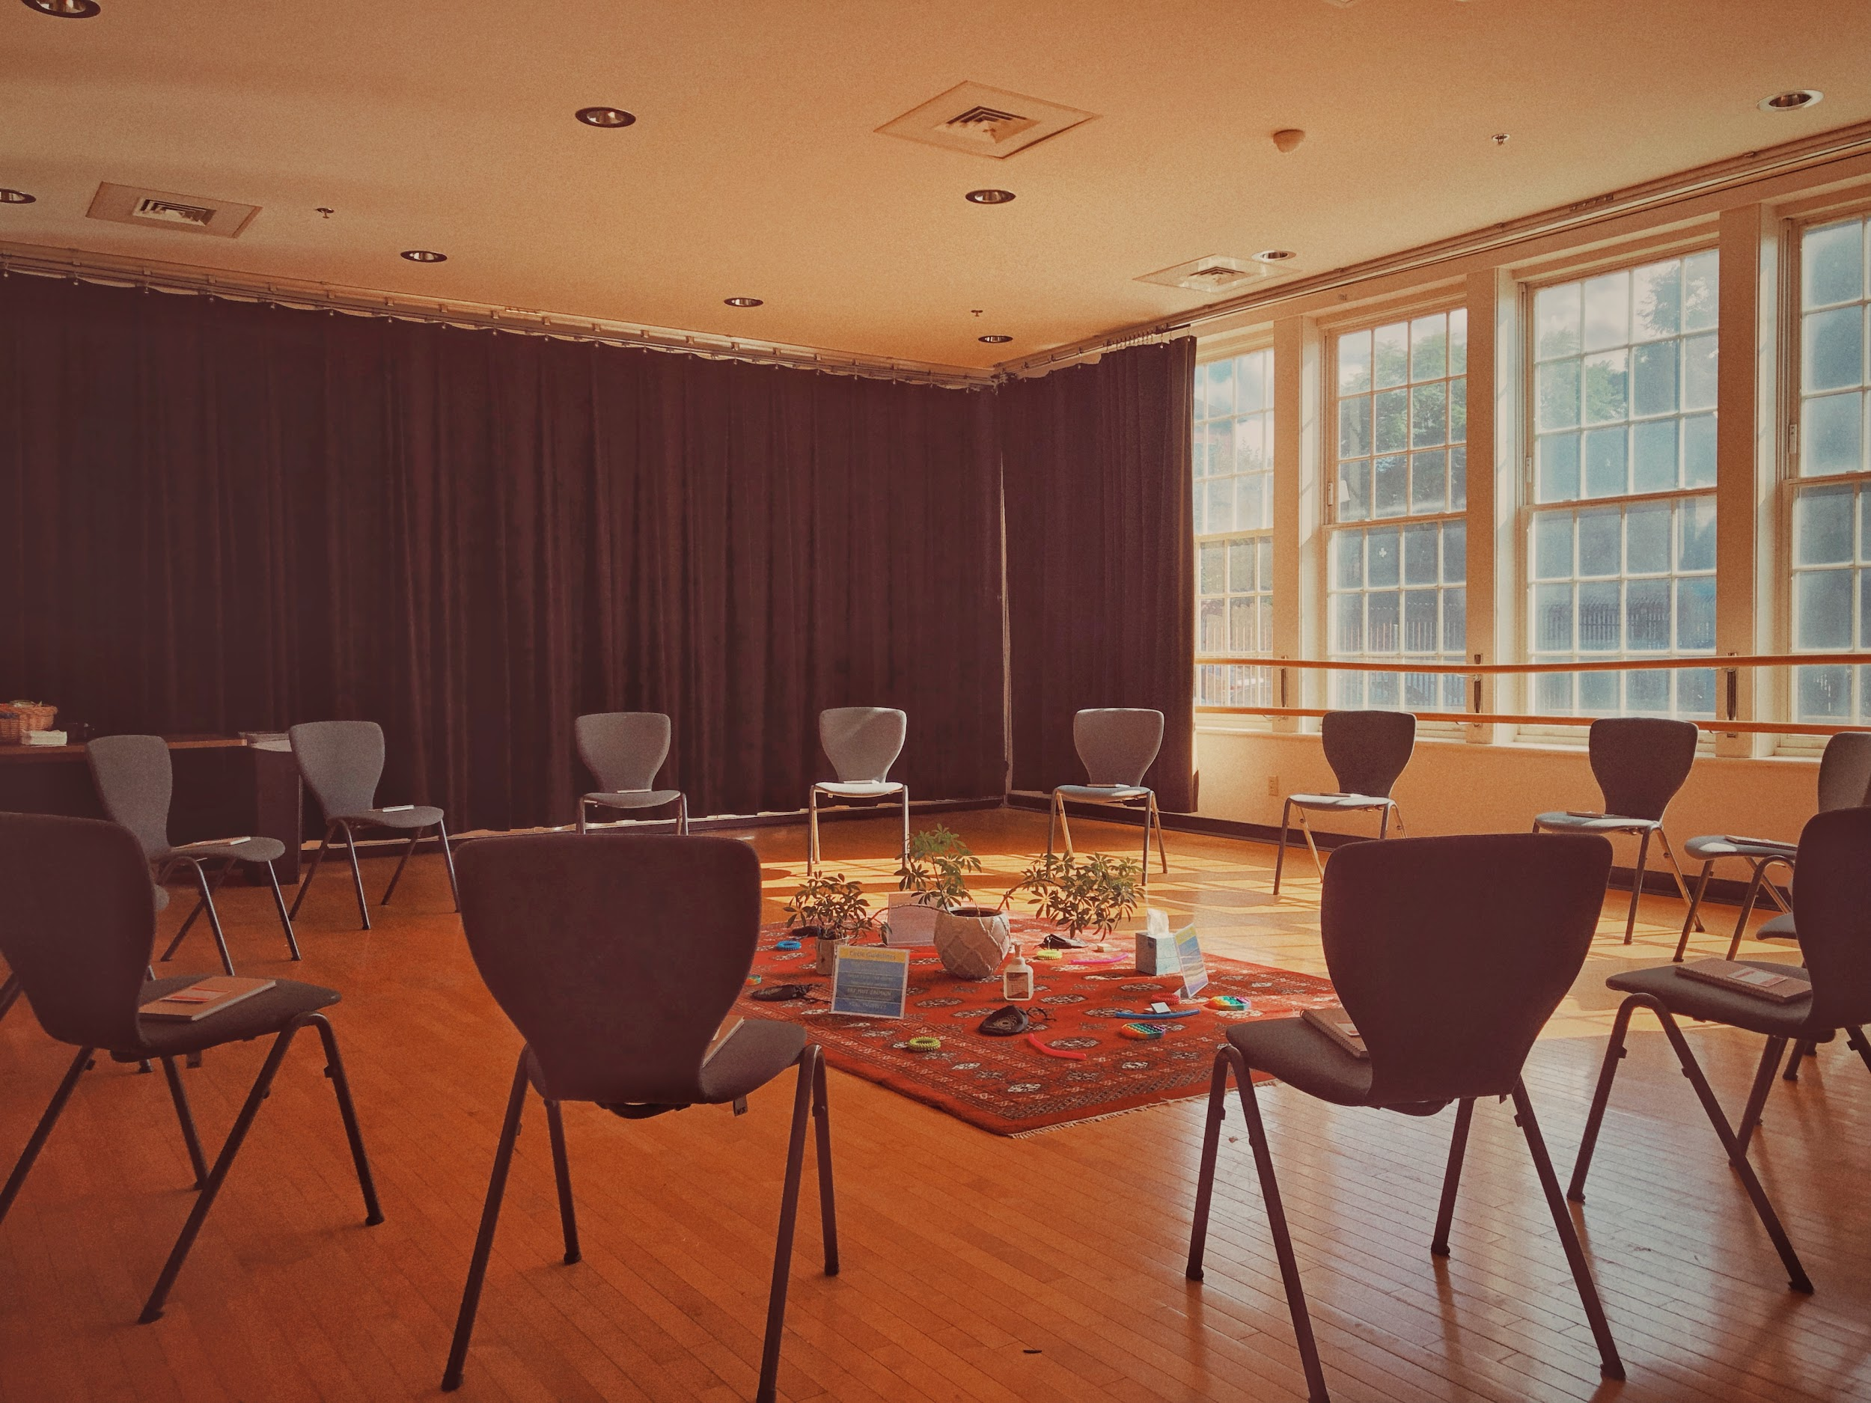
Retributive to Restorative
Accountability
Accountability = Punishment
(Punishment = Pain)
Accountability = Repairing Harm
Keeps people “in community”

Slide 18
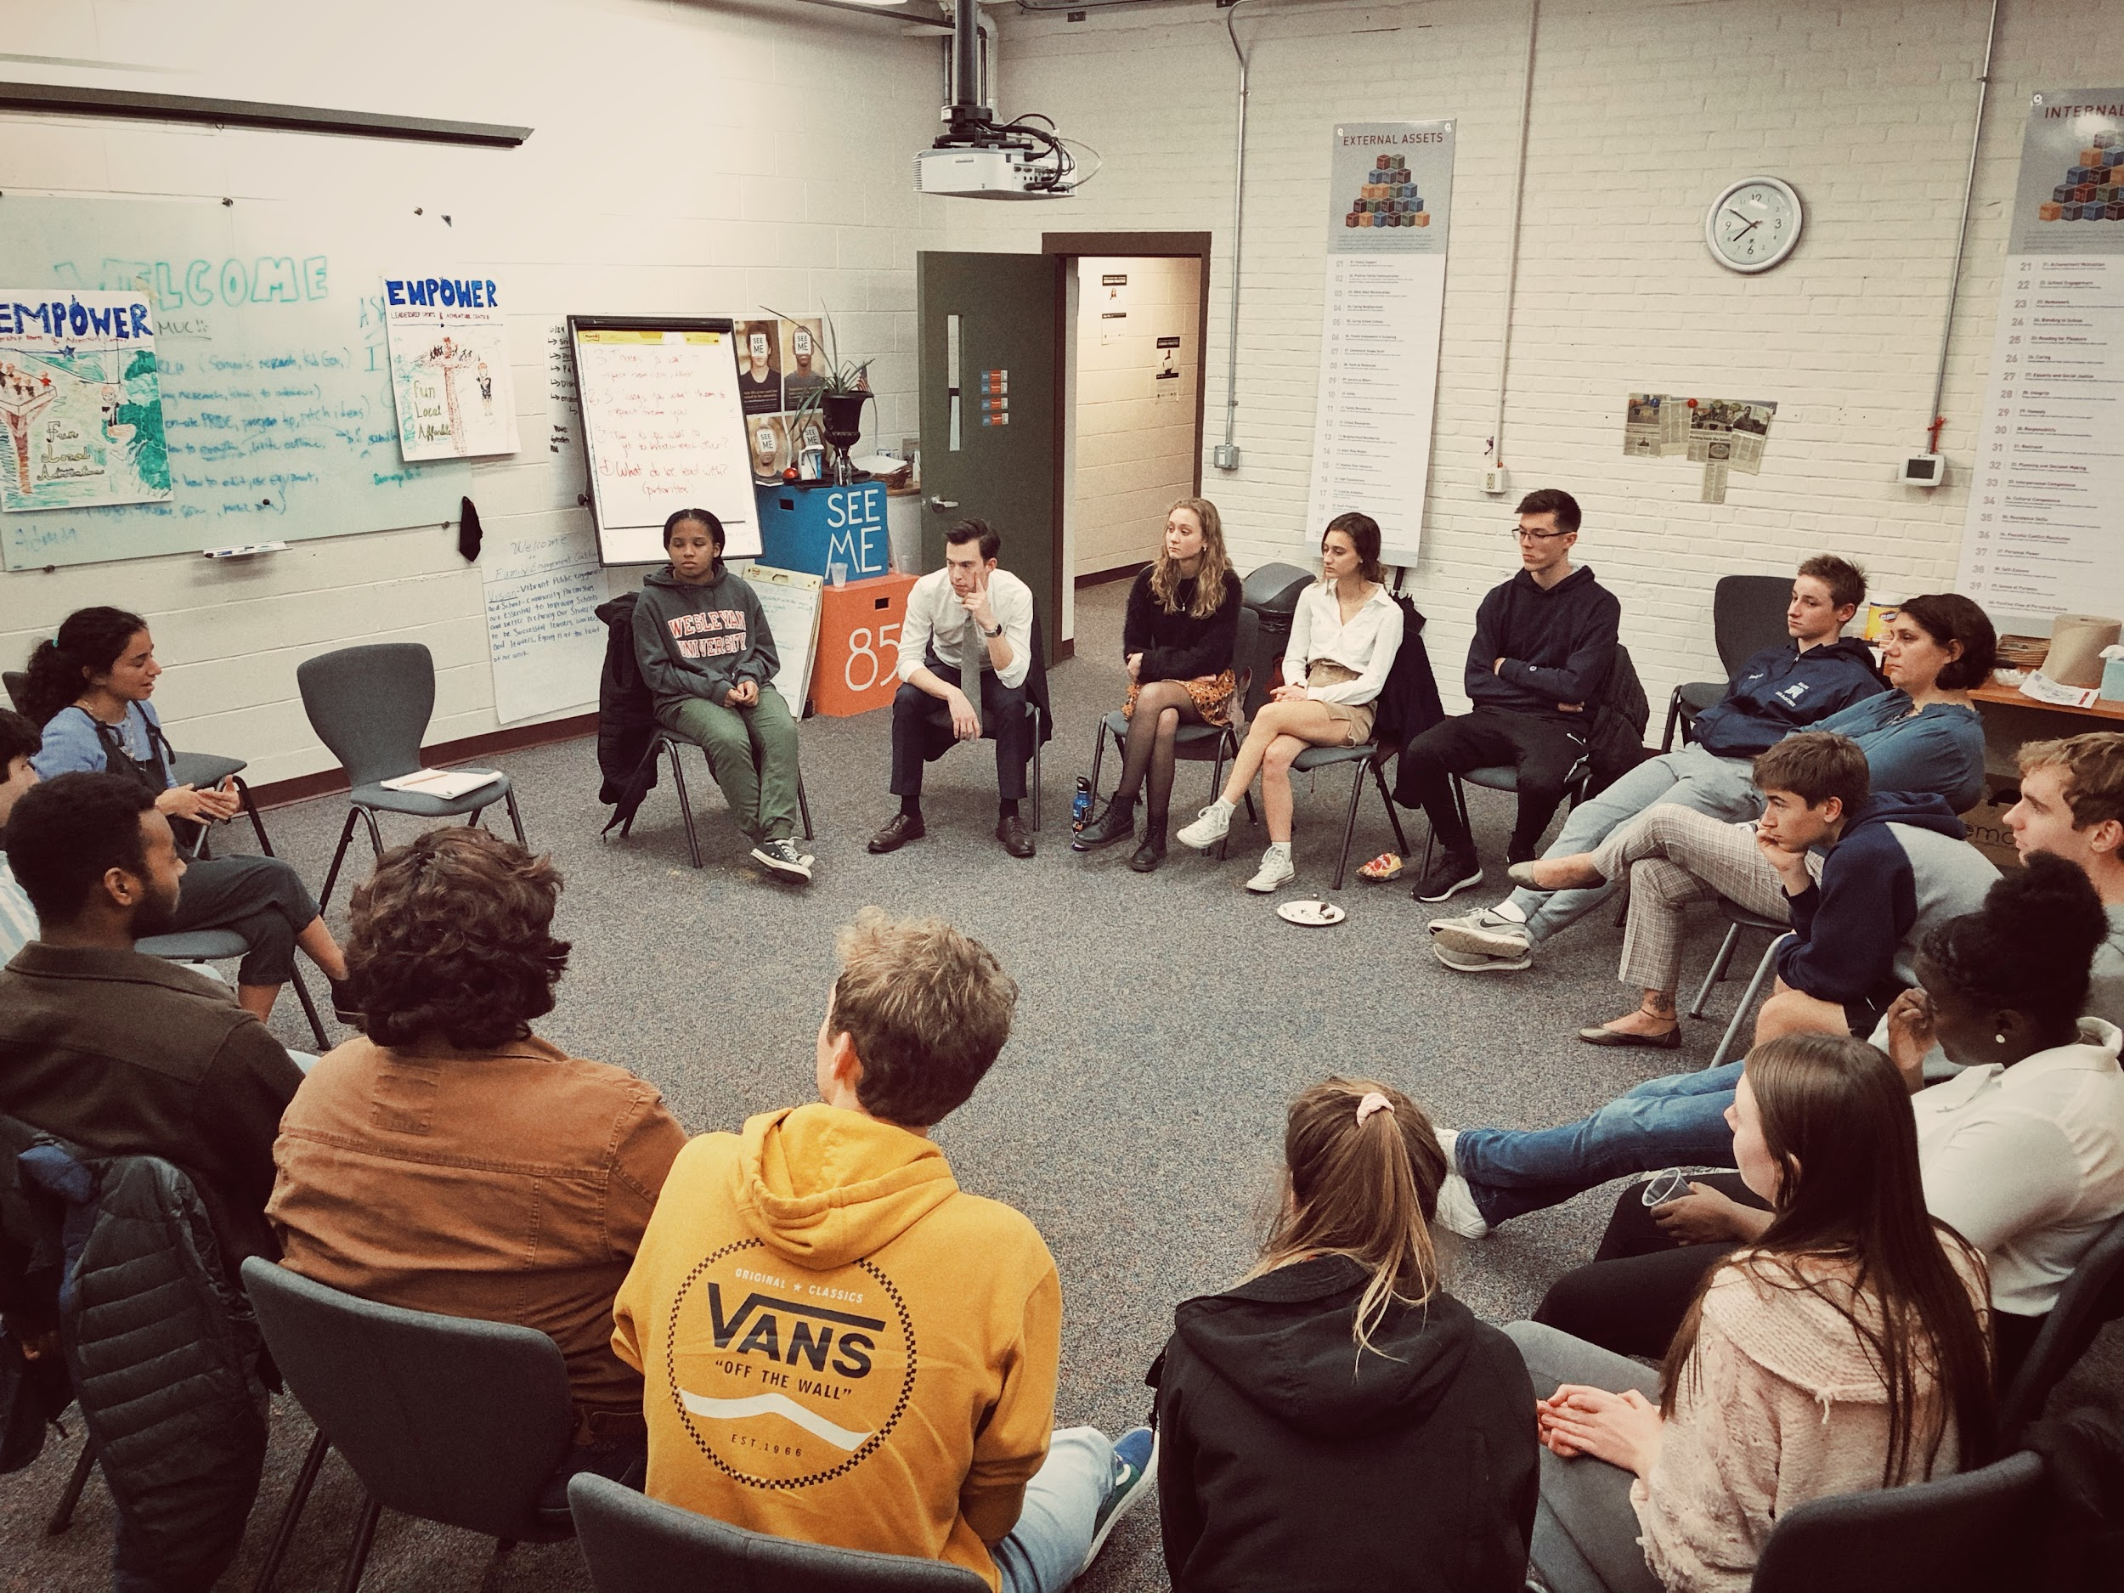
Retributive to Restorative
Accountability
Accountability = Punishment
(Punishment = Pain)
Accountability = Repairing Harm
Keeps people “in community”

Slide 19
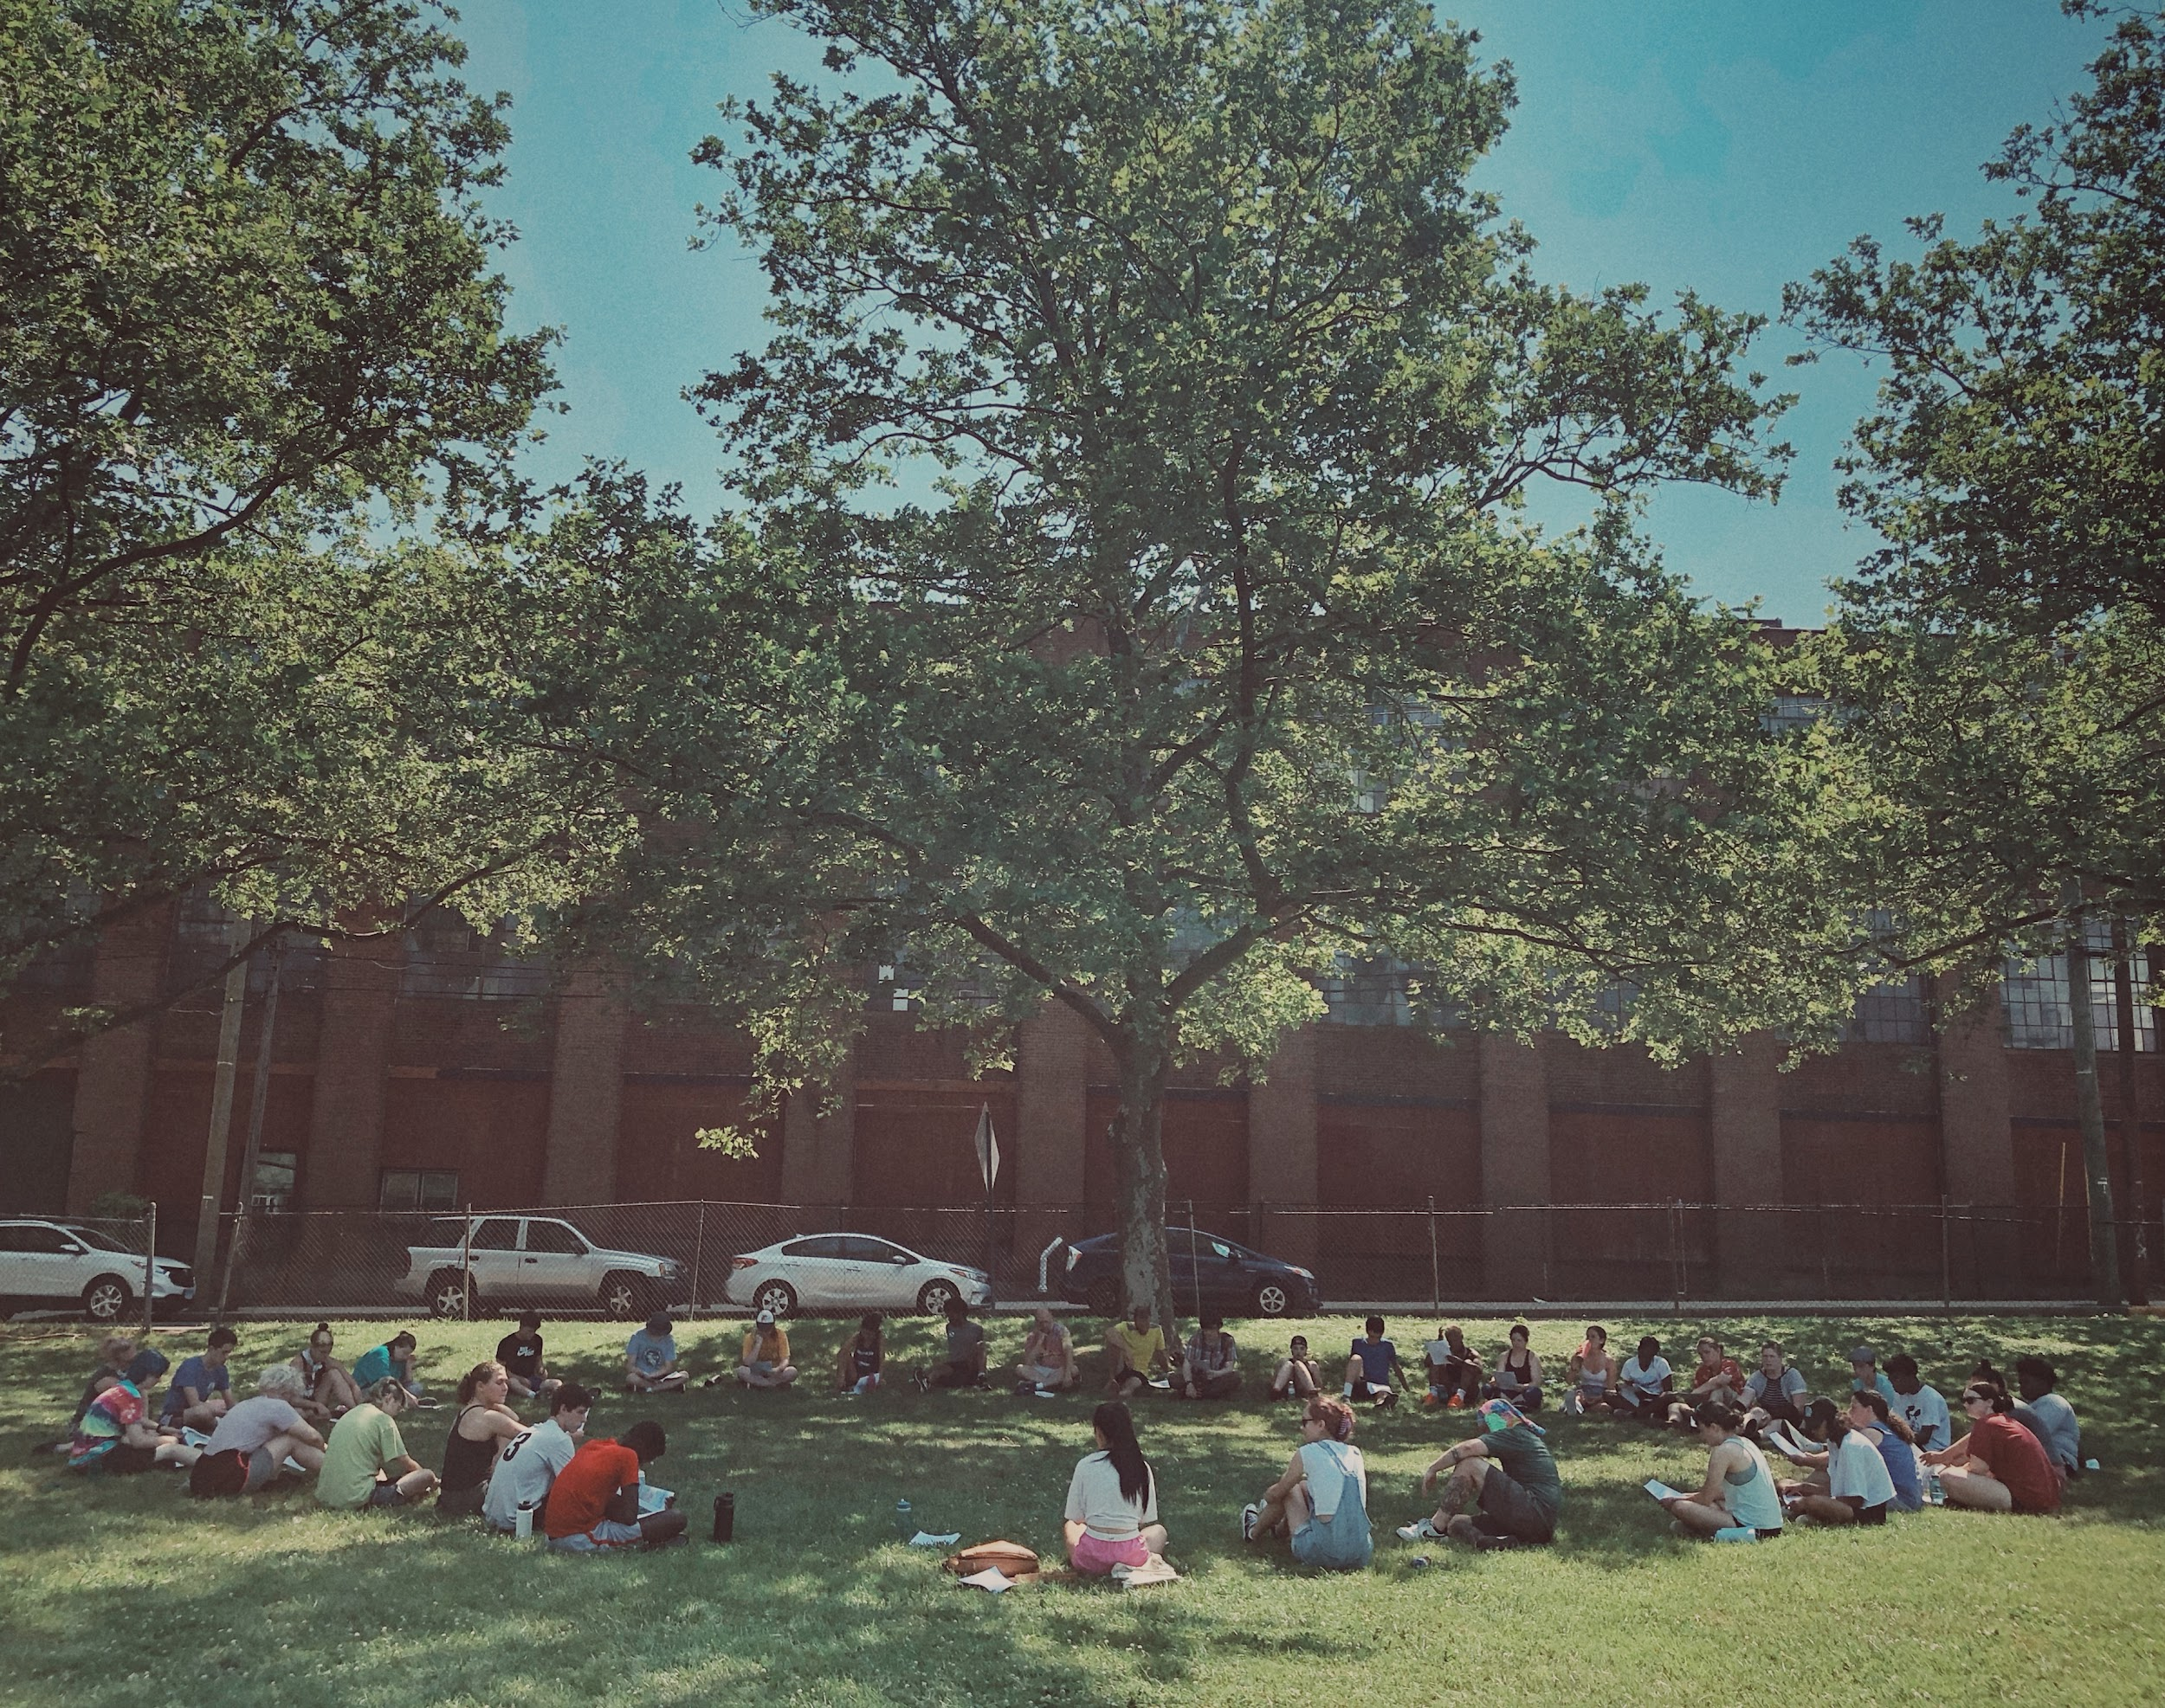
Retributive to Restorative
Accountability
Accountability = Punishment
(Punishment = Pain)
Accountability = Repairing Harm
Keeps people “in community”

Slide 20
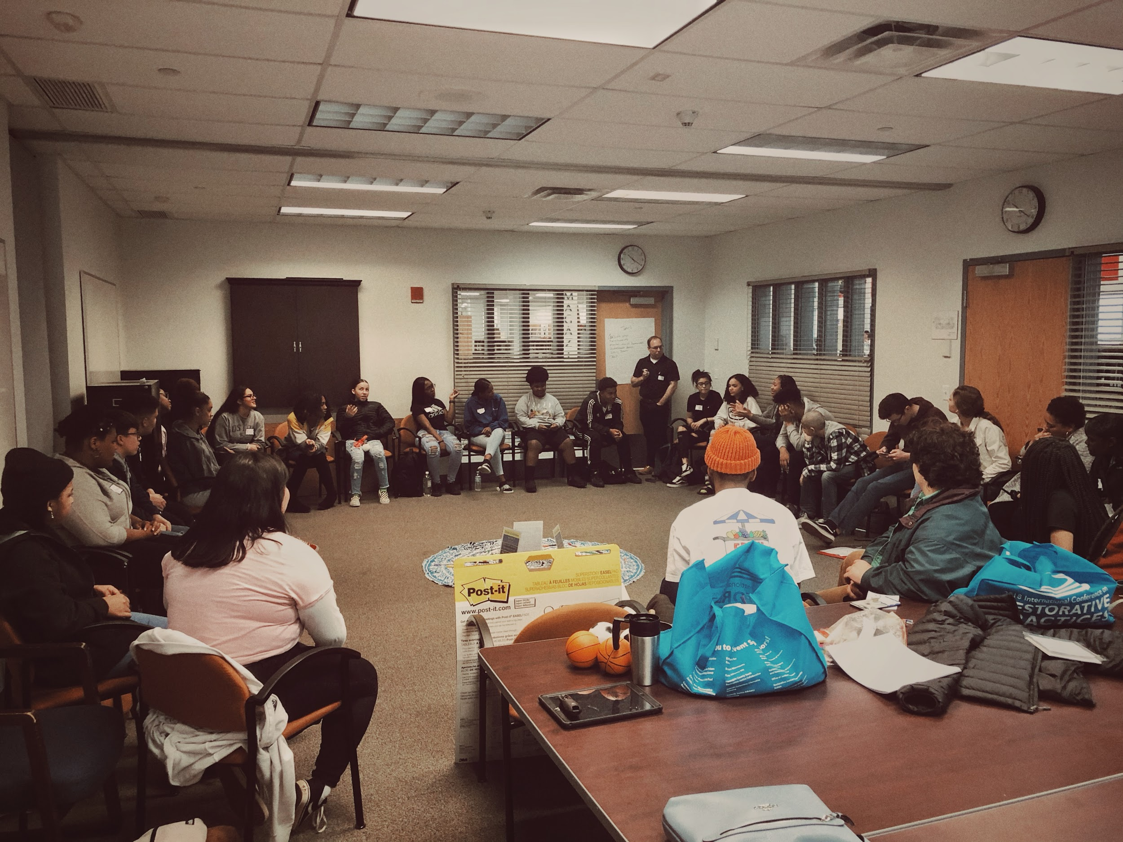
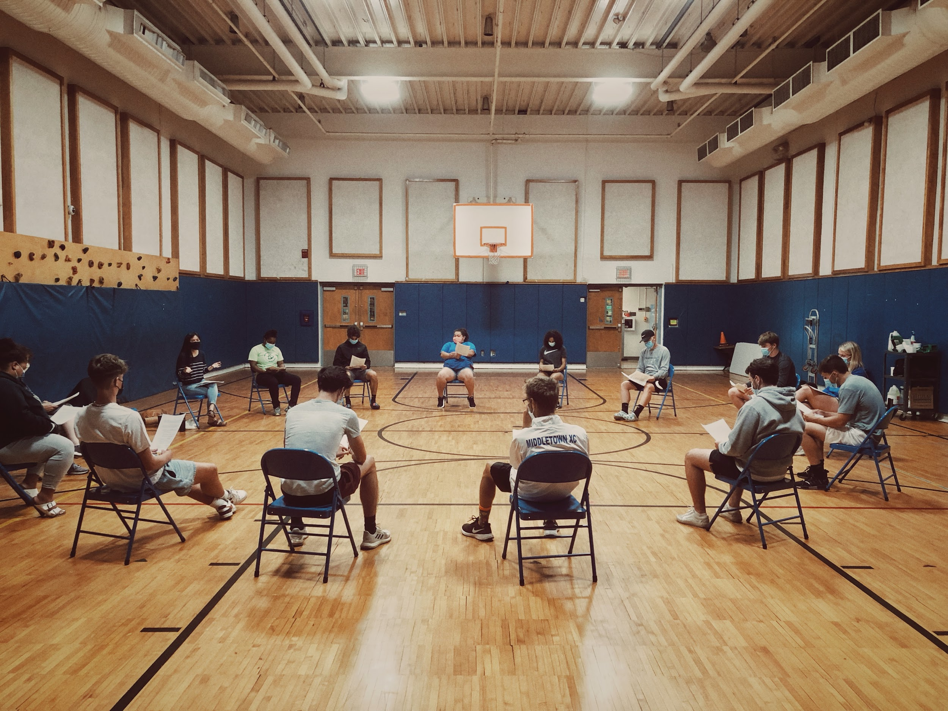
Retributive to Restorative
Accountability
Accountability = Punishment
(Punishment = Pain)
Accountability = Repairing Harm
Keeps people “in community”

Slide 21
Retributive to Restorative
Accountability
Accountability = Punishment
(Punishment = Pain)
Accountability = Repairing Harm
Keeps people “in community”

Slide 22
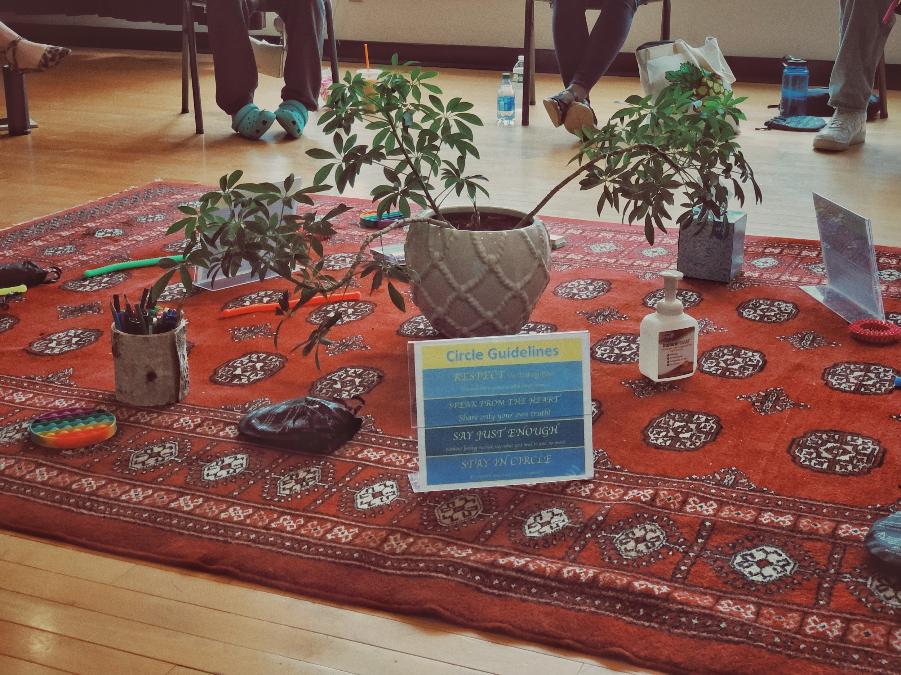
Retributive to Restorative
Accountability
Accountability = Punishment
(Punishment = Pain)
Accountability = Repairing Harm
Keeps people “in community”

Slide 23
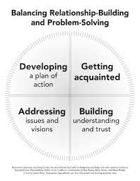

Slide 24
Community Building Circles
Notes:
Should be the majority of the circles taking place
Allows folks to be familiar and comfortable in the circle process before they conflict arises

Slide 25
Conflict
Circles

Slide 26
Let’s talk about stress and trauma
Notes:
Trauma

Slide 27
Regulation
Controlling one's behavior, emotions, and thoughts in the pursuit of long-term goals.
How can you tell if you getting nervous, angry, upset?
What do you do when you start to feel those sensations?

Slide 28
Use Dependent Functioning
Trauma and toxic stress create a hyperactive stress response in humans
FIGHT | FLIGHT | FLOCK | FREEZE | FAWN
If a child has been exposed to prolonged and unpredictable stress, or more traumatic circumstances, this fundamentally alters how the brain’s systems develop. The lower parts of the brain which govern responses to anxiety and fear receive a more comprehensive work-out over time. This is because they are needed to help the child survive regular threats to their safety and well-being.
Meanwhile, the higher parts associated with impulse control, reflection and rational decision-making receive less exercise. Therefore, they are harder to access when the lower parts of the brain are switched on.

Slide 29
State Dependent Functioning
How we feel in situations dictates
how “smart” we are
The brain is also “state-dependent”. How we respond to an event depends on our physiological state at a given time. A child who can more easily maintain and return to a calmer state will be better able to learn new academic concepts and skills. They will also be better equipped to manage social interactions and cope with change and transitions. Such functioning is far more difficult for a child who has experienced frequent and significant stress. Their response will be more often governed by the primitive, survival-focused parts of the lower brain.
This is why a new learning activity, a change in routine or seemingly minor events can elicit an unusual and even distressed reaction. These children are more likely to have stress-response systems which are highly sensitised and over-active.

Slide 30
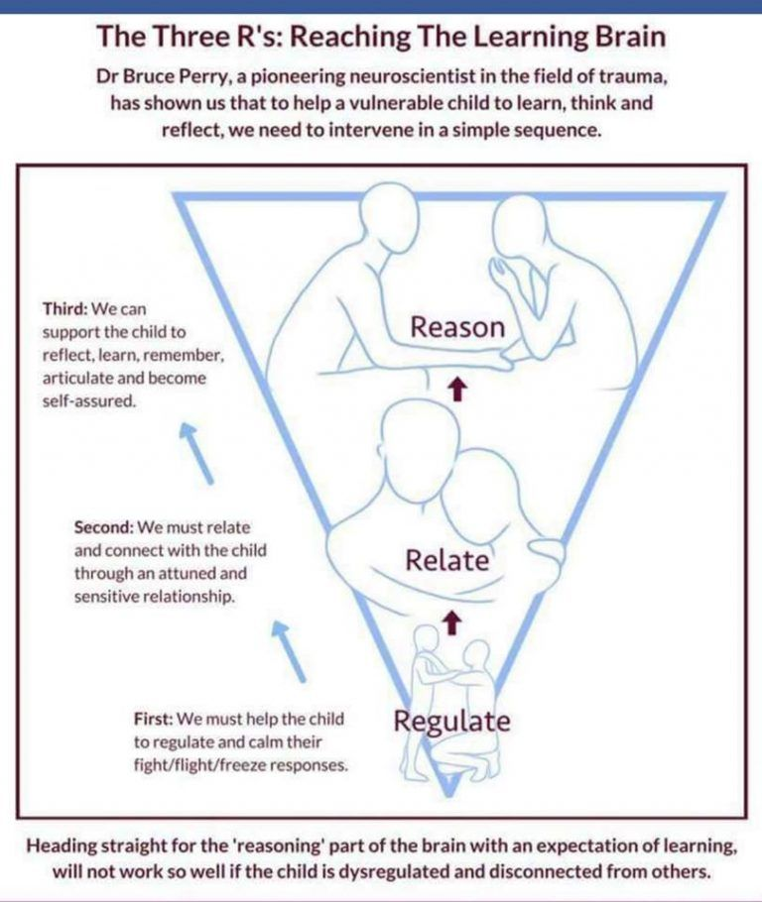

Slide 31
Dr. Bruce Perry, Author “What Happened to You?”
“The most powerful buffer in times of stress and distress is our social connectedness.”

Slide 32
Levels of conflict
S
M
S
L
Small
Medium
Large
Between 2 people. One person goes to another to talk directly about a conflict
When there is a conflict and the people involved want support in having the conversation
Happens when there is a larger group involved or impacted by a conflict
Notes:
Levels:
Happens at all levels of relationships: camper to camper, camper to counselor, counselor to counselor, director to counselor, etc.
Small:
Taking turns – like on the swings – and being frustrated needing to wait
Sharing equipment (or lack thereof)
Structured games and not following rules
Medium:
Pushing or not respecting personal space
Large:
Violent behavior, gossip
Common camp situations:
Structured games and not following rules
Sharing equipment (or lack thereof)
Pushing or not respecting personal space
Taking turns – like on the swings – and being frustrated needing to wait
Bus etiquette – staying seated, respecting space
Listening/following rules in new locations such as pool or field trips
Gossip
Less common but still occur:
Hateful/hurtful language
Serious aggression/violent behavior
In situation where many people are annoyed with one camper, can check in with that camper and see if there is anyone else they connected with that could come and sit with them in the circle
Makes it feel like the goal is to problem solve together and less confrontational

Slide 33
1. What
happened?
CONFLICT
CIRCLE
QUESTIONS
4. Request/ Agreements
2. ID the impact/harm
3. What do you need to move forward?
Notes:
Goal of having restorative tool for people to use is to let people know that their voices and opinions matter and what happened matters
Formal, intentional way of empathizing
Happens in a systematic way which reduces bias and allows for power sharing
Round of circles:
Community agreements are outlined
Everyone gets opportunity to speak in a round, folks can pass
Helpful to start by answering yourself or trying to choose someone to start who you know will answer
Everyone shares what happened for them
Everyone needs to get an equal opportunity to share, no interrupting
Asked to speak directly to each other
“I felt… when you...”
Everyone shares how they are feeling because of the conflict
Everyone shares what they are needing
Might be in a system at camp or from people in the circle
Forming agreements to move forward
Trust folks to come up with their own solutions
Fluid:
This guide is in a circle not a straight line, and are a guide not a script -- can go back and forth or word questions differently
Meet every new situation and conflict where it is at depending on the dynamic of the group
Each circle and outcome are different
People won’t always be friends after -- not always a perfect ending
Can come back into the circle again and again
Troubleshooting:
If someone feels frustrated or attacked can ask them to invite someone else that they have built trust with -- friend, councilor, camper -- who can sit with them during the circle; can help folks see we want to get to the root of what happened without focusing on blame or shame
If people are being too heated, facilitator can stop circle and say we will come back to conversation, tensions still feel really high and I’m not sure we are ready for this conversation
Let people work through thoughts and feelings ahead of time
On facilitator to express concerns as well
“I’m concerned you are sounding ____ and I’m worried how ___ might be feeling.”

Slide 34
Allowing proper time to talk
(and listen)

Slide 35
Modeling: Authenticity
Vulnerability
Caring

Slide 36
You find what you search for World view dictates behavior

Slide 37
Trust the group Trust the process

Slide 38
Questions?
Feel free to reach out!
Justin: Justin.Carbonella@middletownct.gov

