Slide 3
Advocacy
A voice for children and youth
Media relations
Local and state officials
State funding
Supporting/creating legislation & policy
Networking
Proactive youth trends
Increasing awareness on youth needs

Slide 4
Advocacy
The voices of children and youth
Media relations
Local and state officials
State funding
Supporting/creating legislation & policy
Networking
Proactive youth trends
Increasing awareness on youth needs

Slide 5
A Bridge to the Future: Engaging youth in community decisions.

Slide 6
Engagement Theory: Social Discipline Window

Slide 7
Engagement Theory: Developmental Relationships

Slide 8
From the “ground”: Keys to Engagement
R-E-L-A-T-I-O-N-S-H-I-P-S
Provide Context
What’s their role?
What’s been going on?
Provide Capacity
Build their perspective / educate
Teach skills and practice
Provide models and build outlines
Build confidence
Avoid Tokenism
Make it “culture”

Slide 9
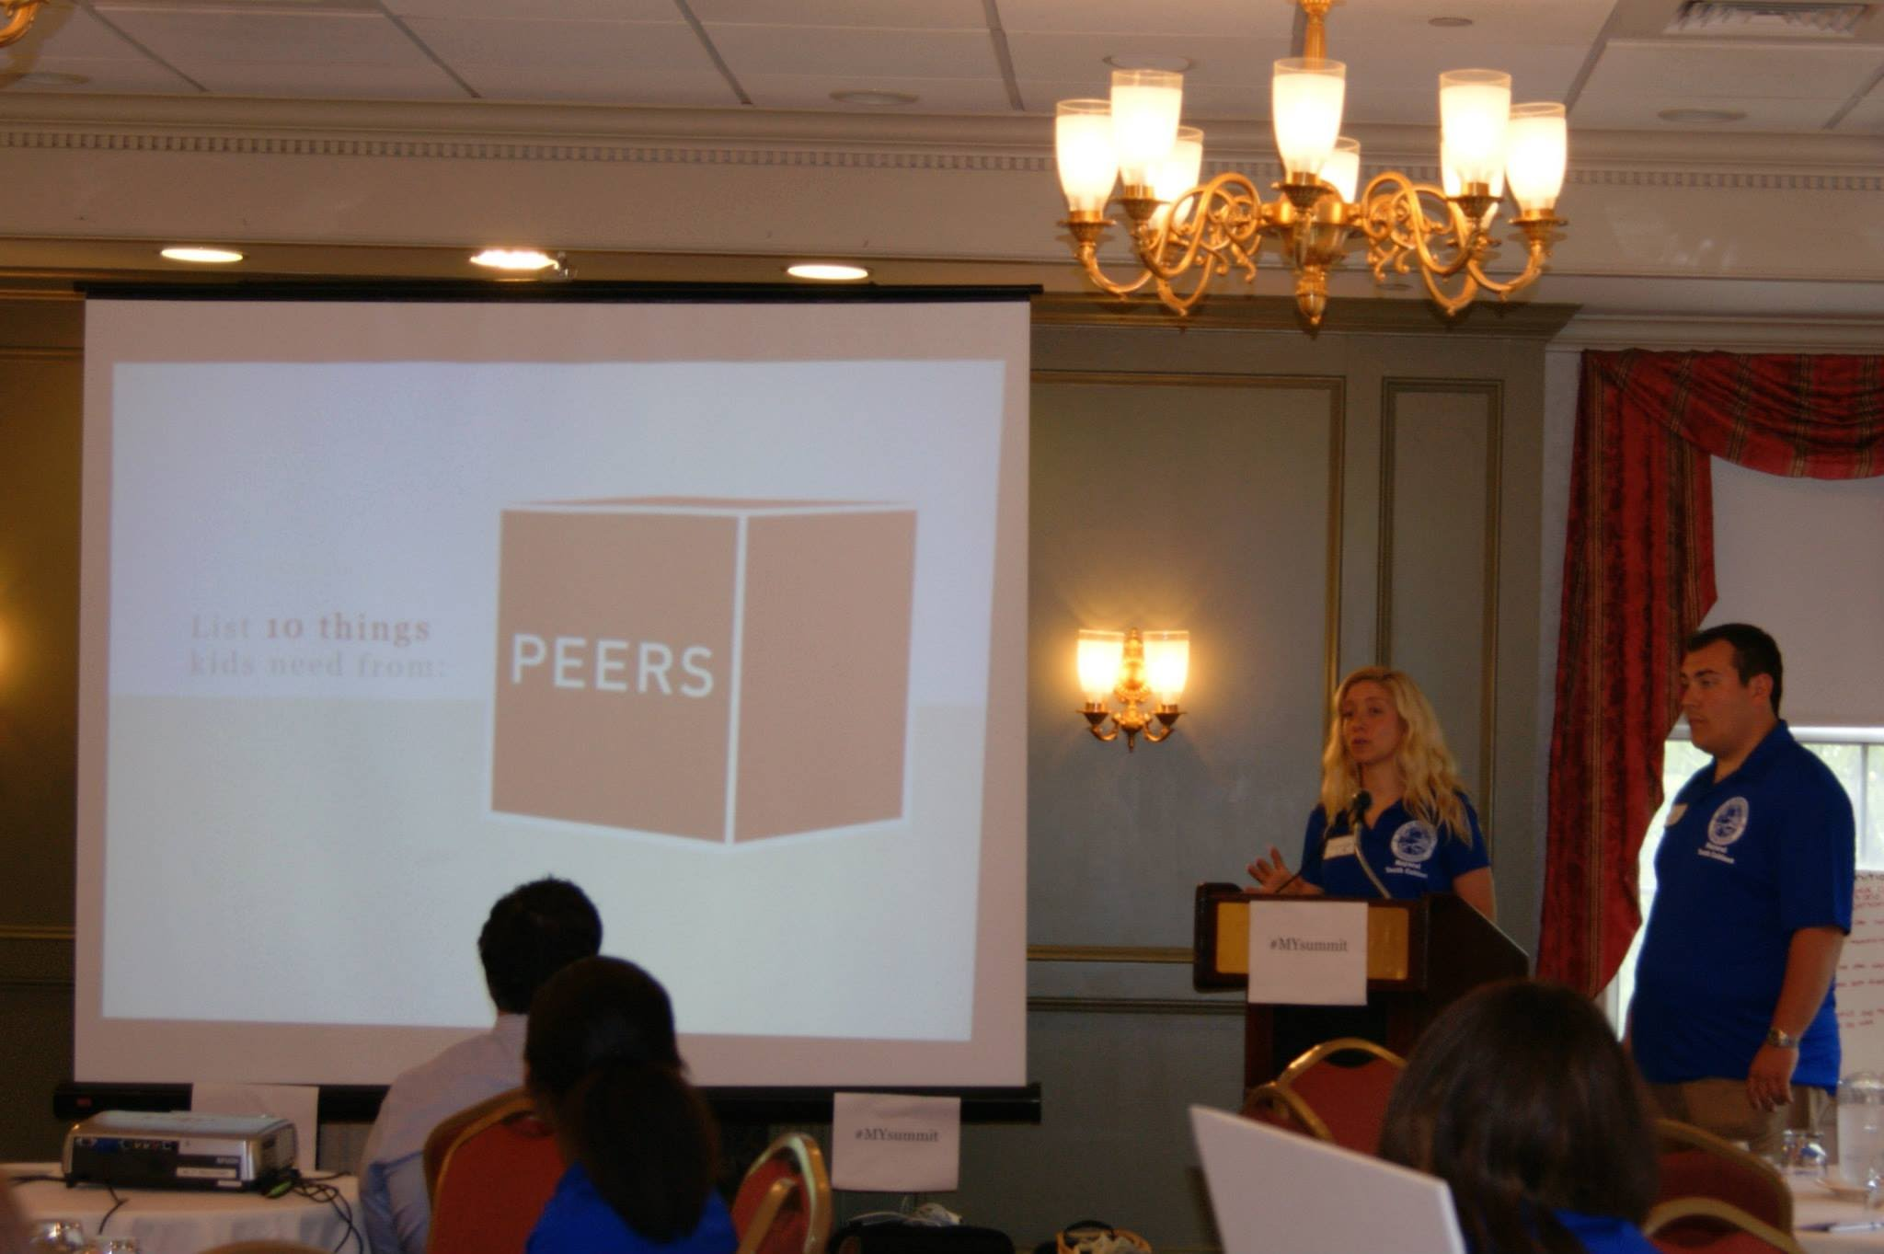
SHARING POWER
Asset Builder of the Year Awards
Mayoral Youth Cabinet Summit

Slide 10
Opportunities that Truly Engage
not “to” / not “for” / but “with”
youth as resources
youth as actors

Slide 11
Opportunities created in Middletown

Slide 12
Youth in Government

Slide 13
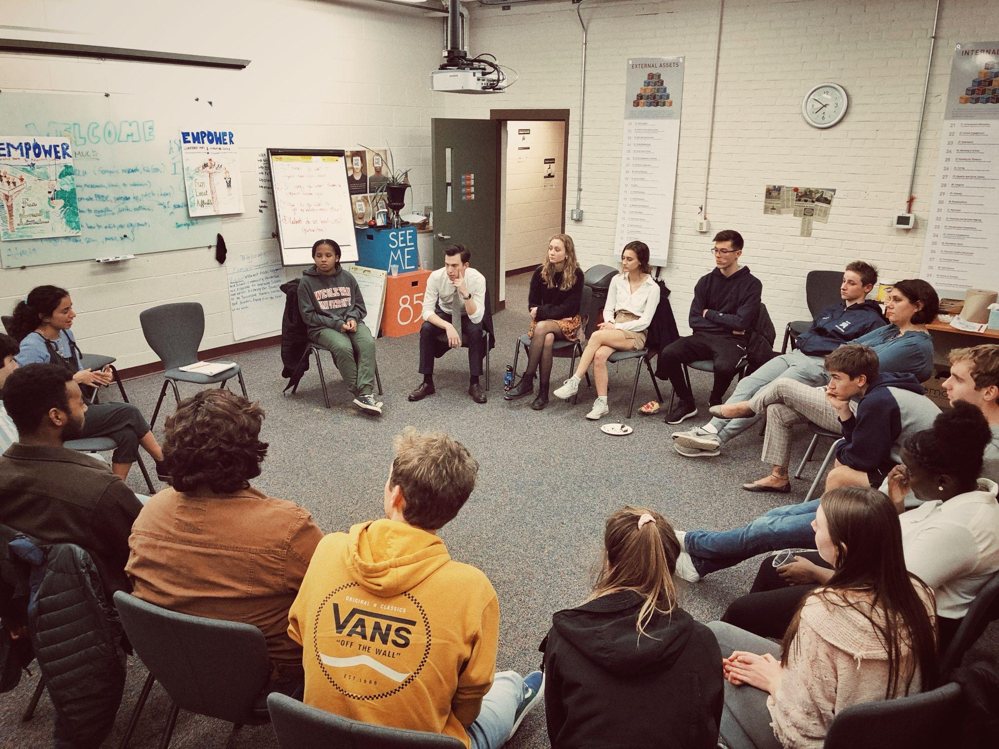
Mayoral Youth Cabinet

Slide 14
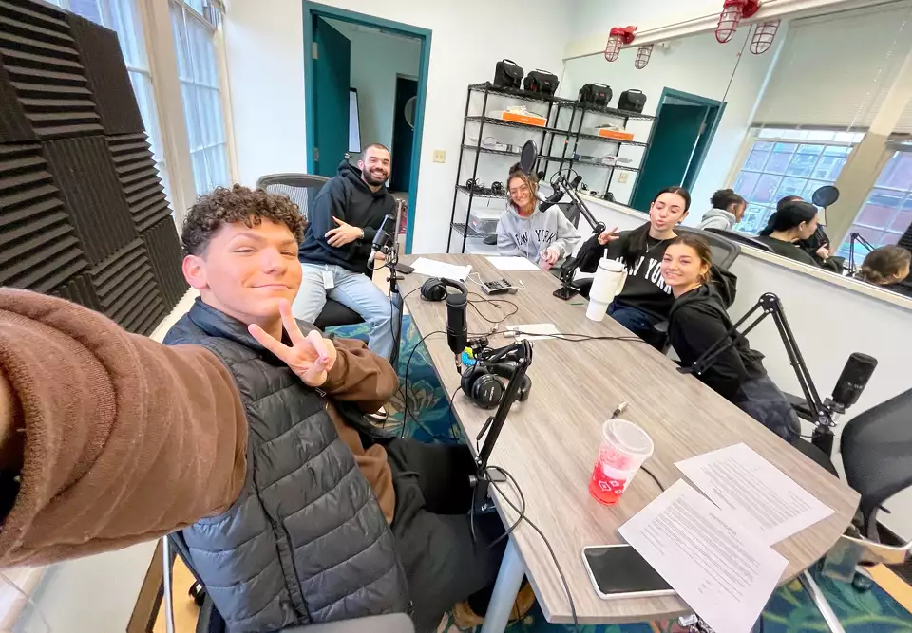
Talks Too Much

Slide 15
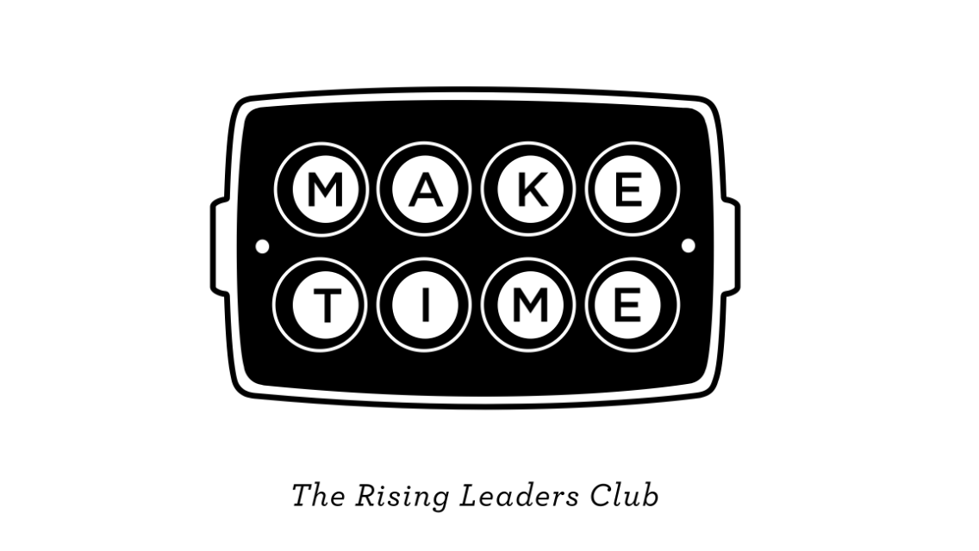

Slide 17
Advocacy
A voice for children and youth
Media relations
Local and state officials
State funding
Supporting/creating legislation & policy
Networking
Proactive youth trends
Increasing awareness on youth needs

Slide 18
Considerations…
Leave it to the professionals
Recognize it as an investment
Gift and the curse of YSBs
Embrace the complexity – Jack of all trades…
Tell your story – We’re all different
Brand yourself
Find your audience and build
Target them differently if you need to
Make friends in the media
Understand the hierarchy/politics
Mindfulness in media
R-E-L-A-T-I-O-N-S-H-I-P-S
Local and state levels

Slide 19
Social Media Presence
Go slow (ok to be risk averse)
Dip the pinky
Find your voice
Understand the culture of the medium and your audience
#Facebook
Do research
What works/theory
What’s out there
Ok to try things out
(Remember what we just said) Use young people

Slide 20
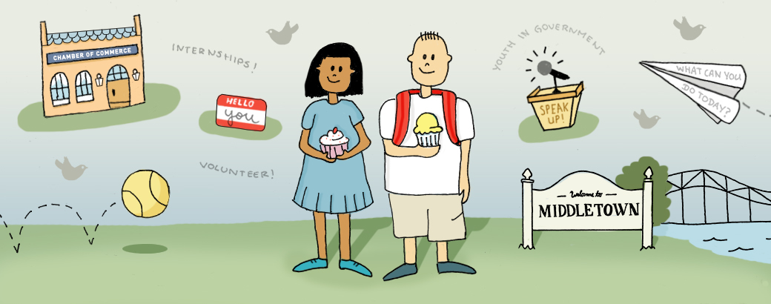
Keep in touch:
@middletownyouth
Facebook.com/mtownysb
860-638-4530
justin.carbonella@middletownct.gov

