Slide 1
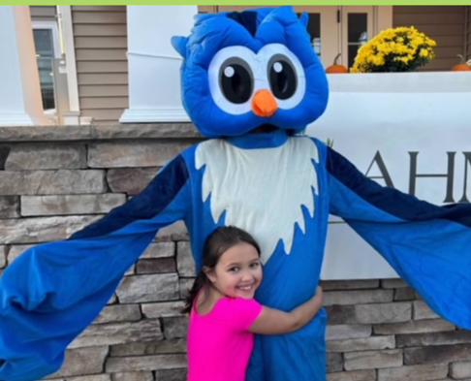
Reaching Your Community Through a Multi-Media Marketing Approach

Slide 2
Marketing your YSB- Strategy
Print Marketing with QR Codes
TV, Other
Social Media
Email Marketing
5 Channels
Constant Contact
Brochures
Flyers
Newsletters
Postcards
Community Voice Channel
“AHM Today”
AHM’s Website – Registrations, Resources, Donations

Slide 3
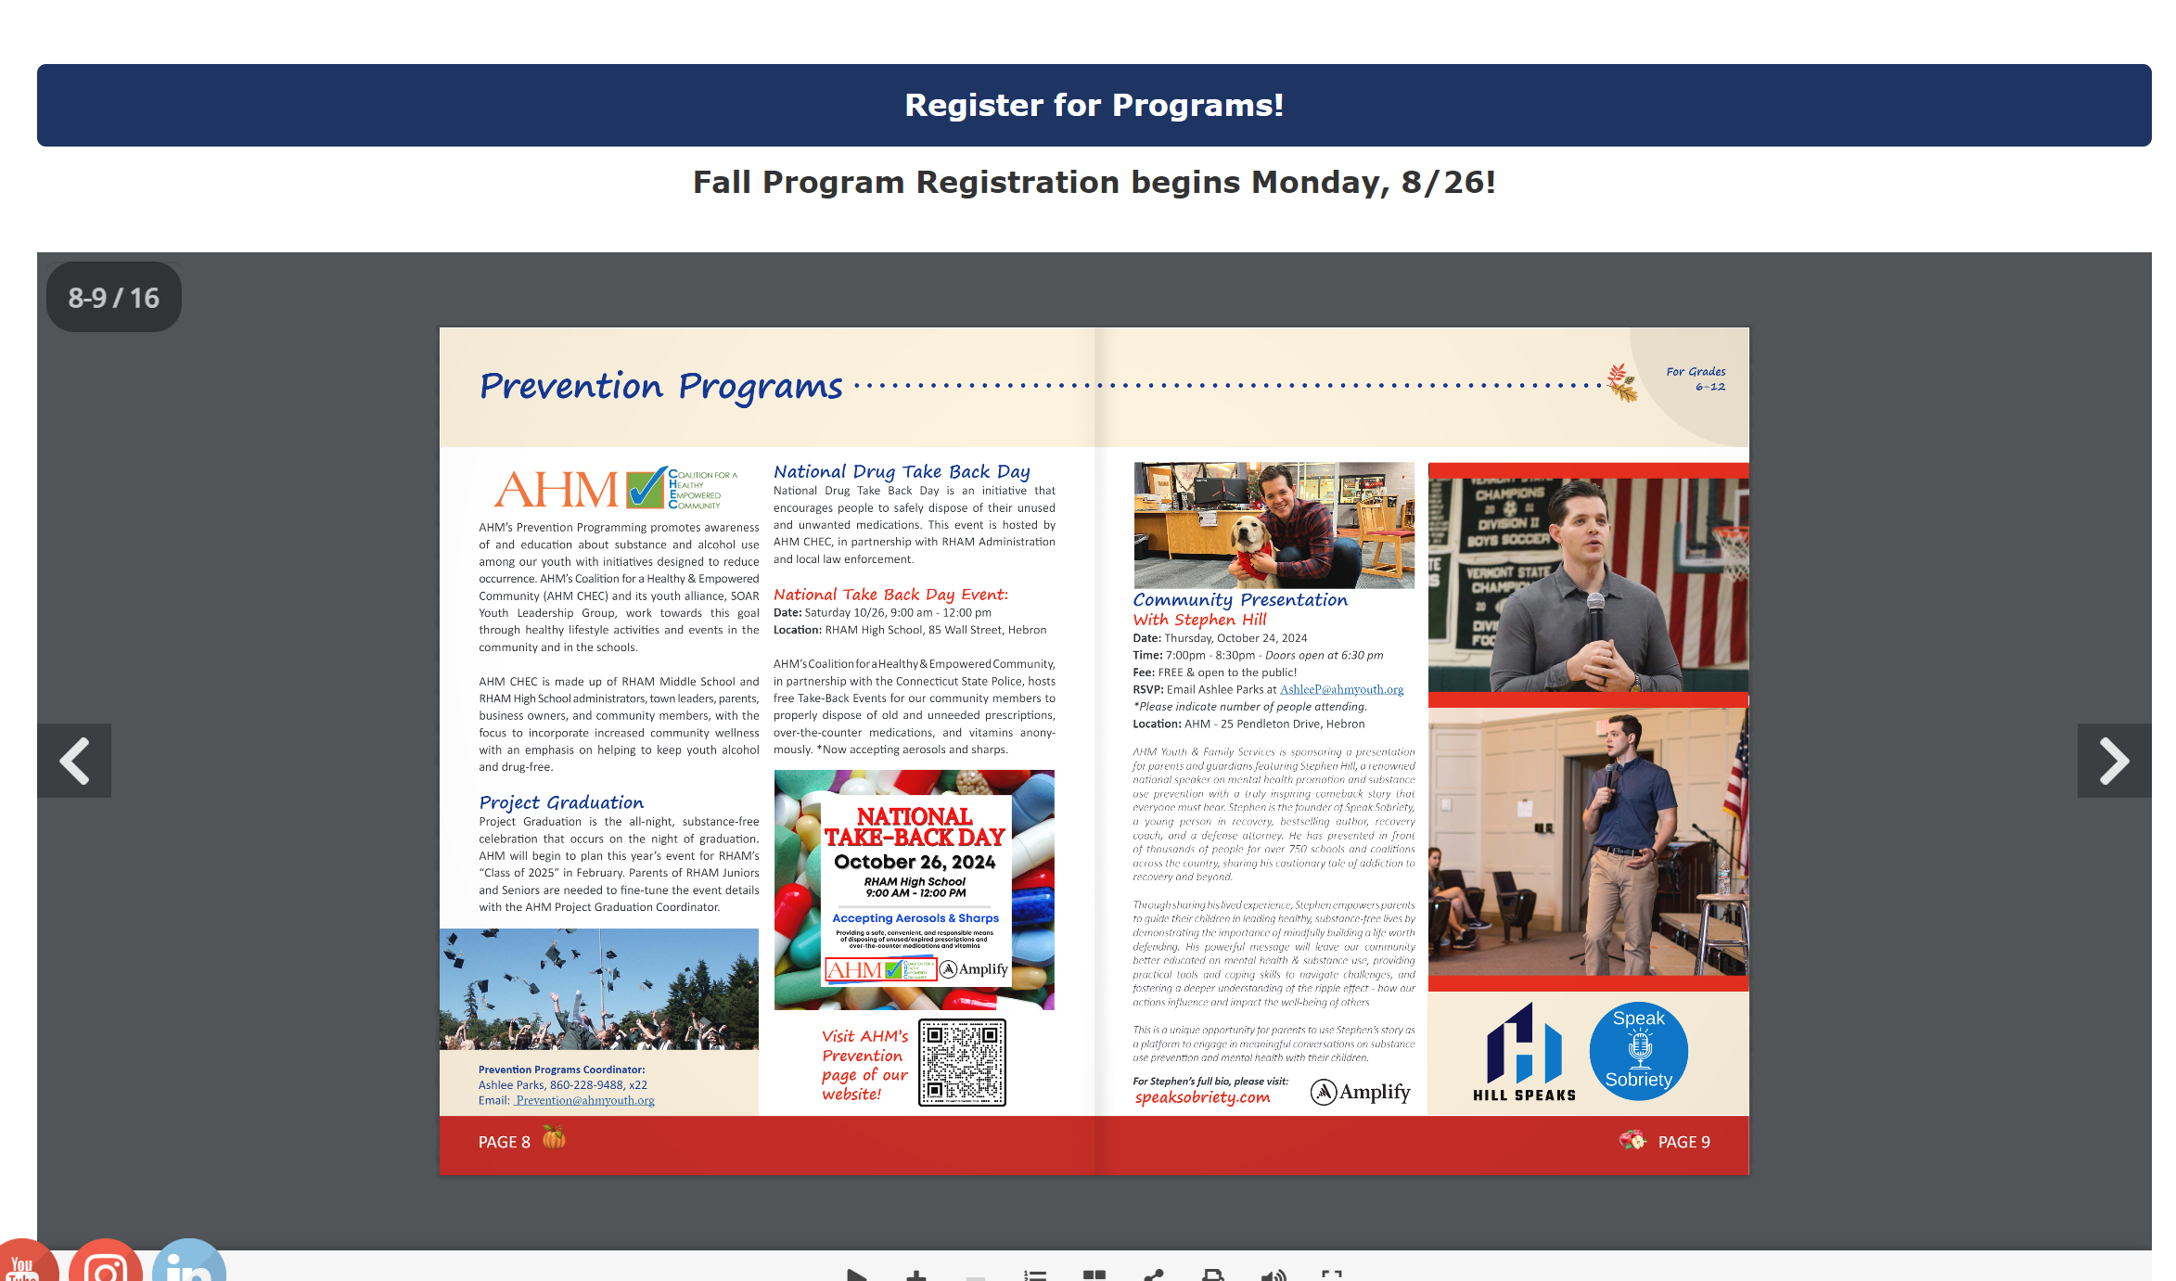
Programs and Services Brochure

Slide 4
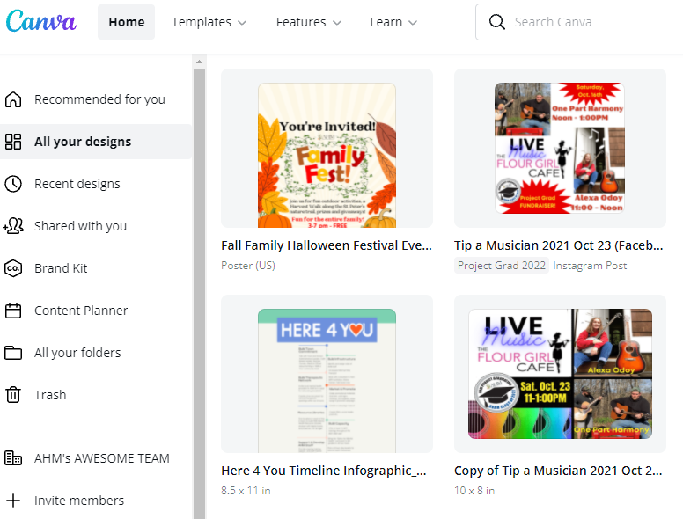
Content Creation
Easy resizing
Templates
Save by folders
Multiple users
Free on mobile
Discount for non-profit

Slide 5
Use of Social Media
Multi-channel Approach

Slide 6
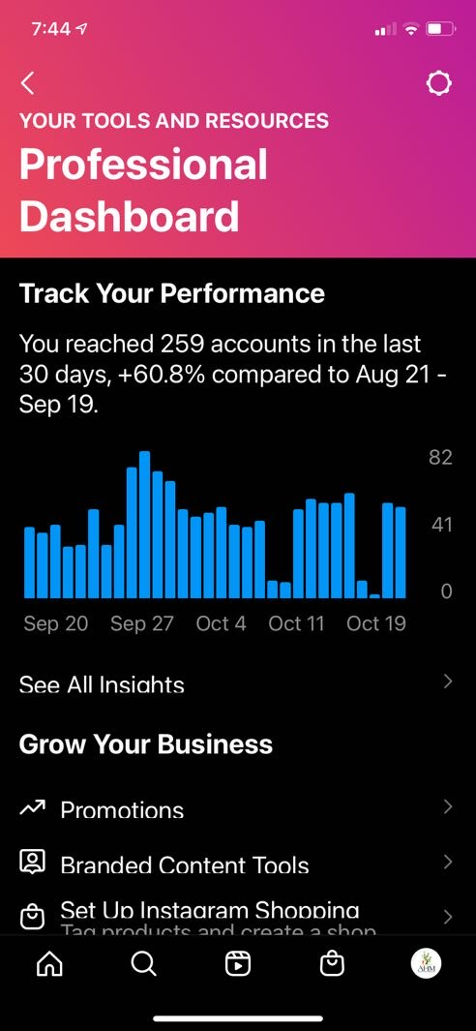
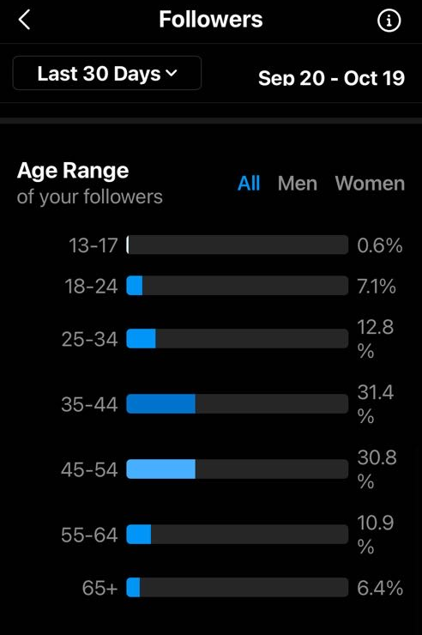
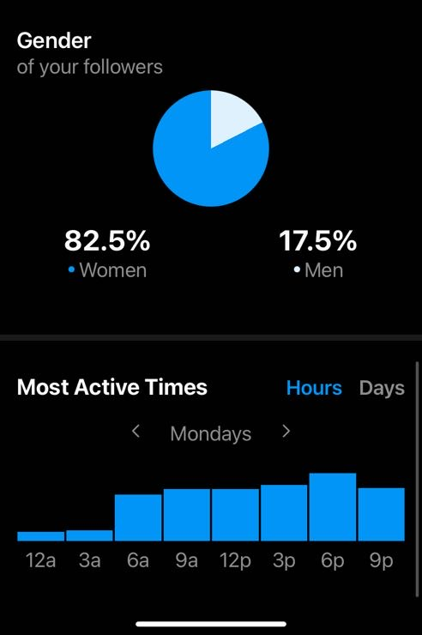
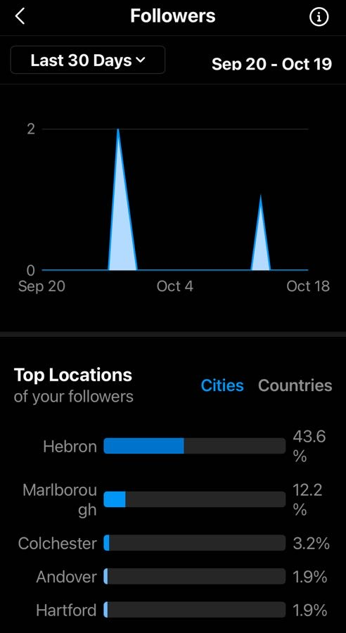
Instagram- Mobile

Slide 7
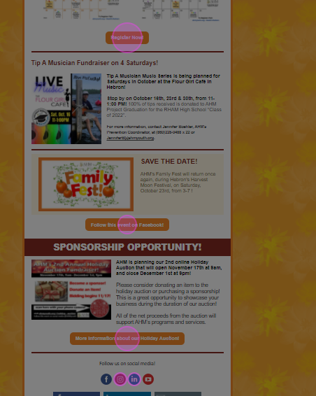
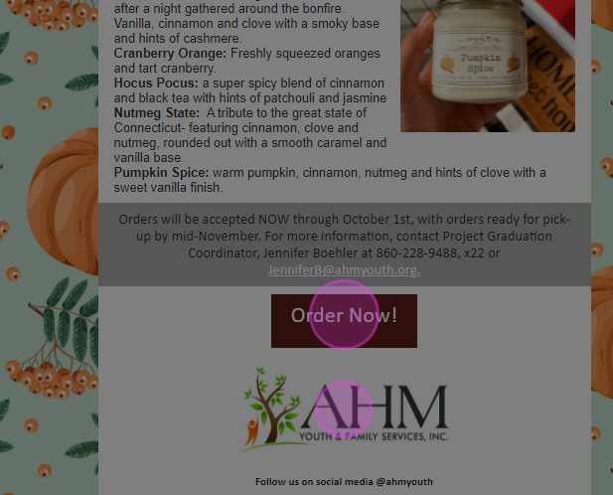
Heat Map

Slide 8
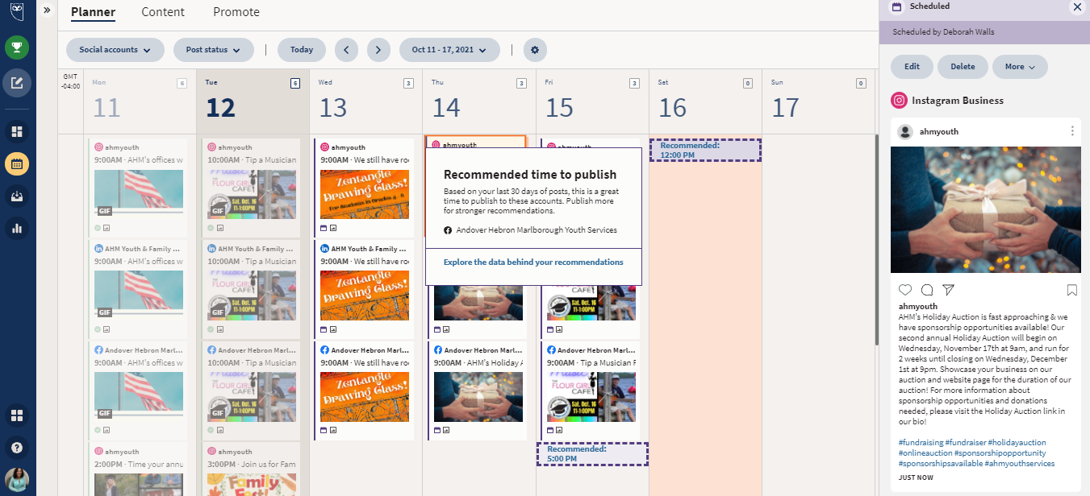
Social Media Management Tool
Recommended times to post, ability to duplicate posts to save time

Slide 9
Content Creation Workflow
Approval
Content Scheduled
Content Written
Content Designed
Adobe, Canva,
Animoto, Flowcode, Constant Contact
Hootsuite Constant Contact
Press Releases
All drives traffic to website & registration platform

Slide 10
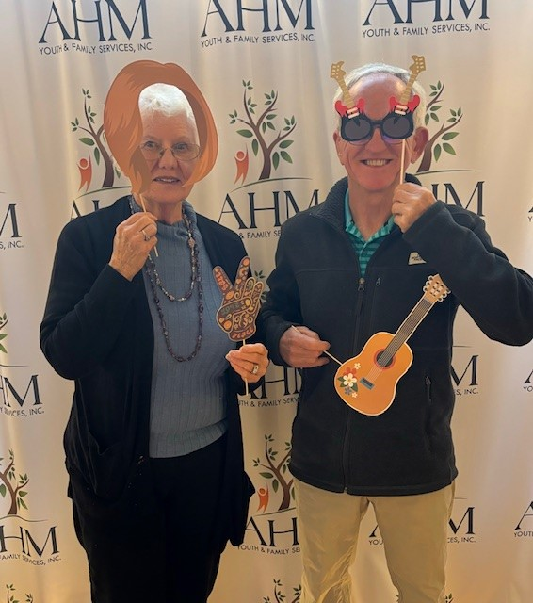
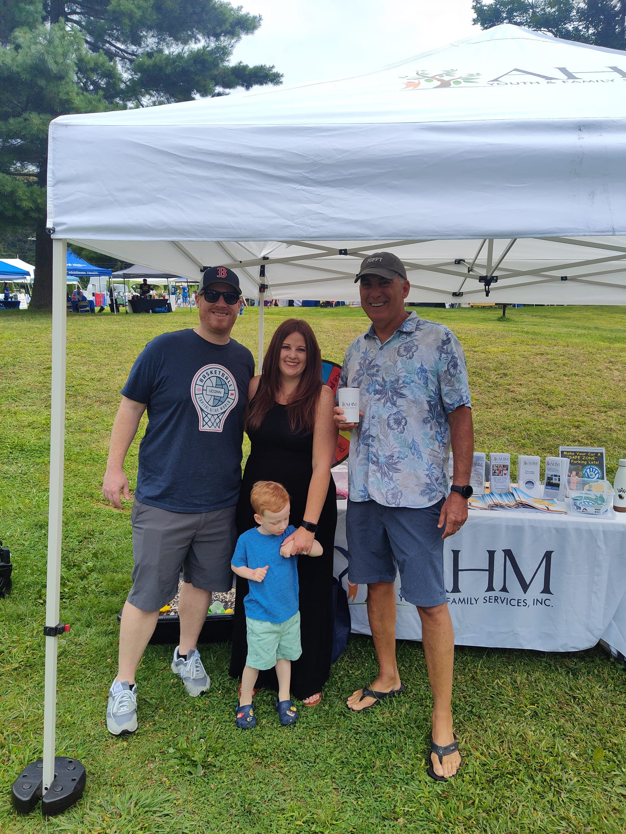
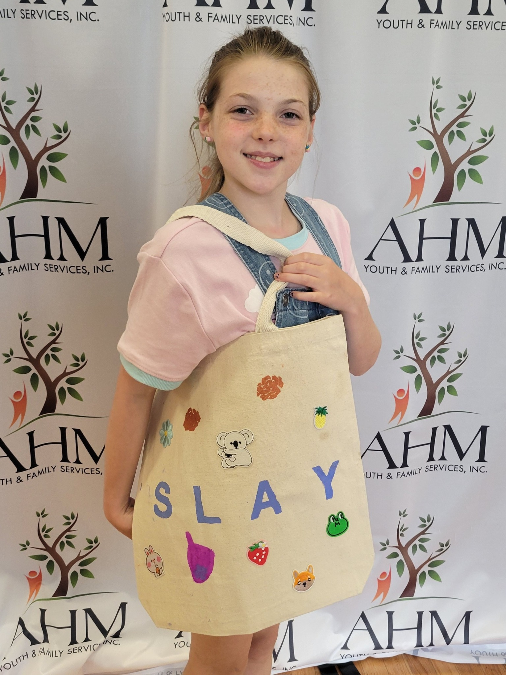
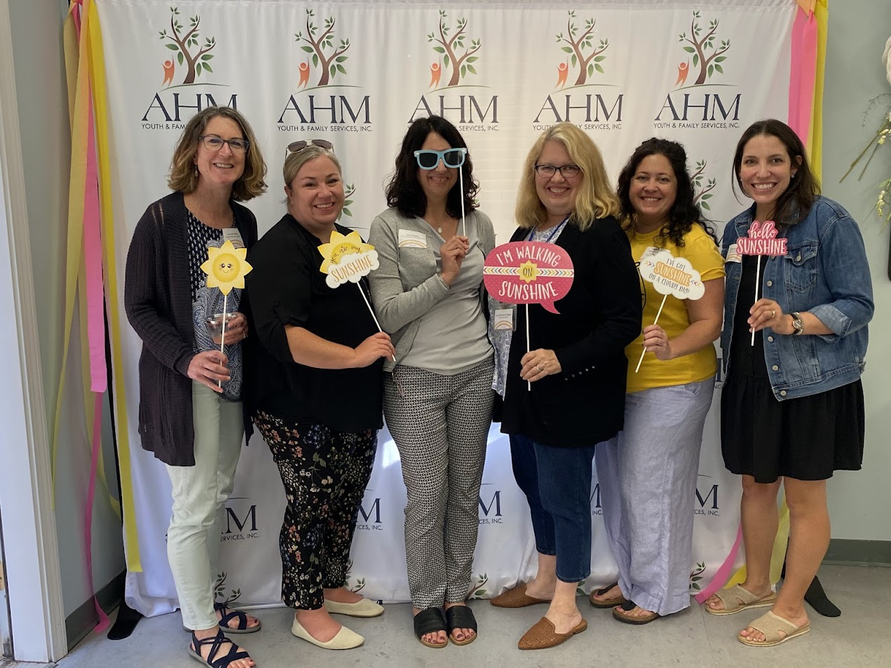
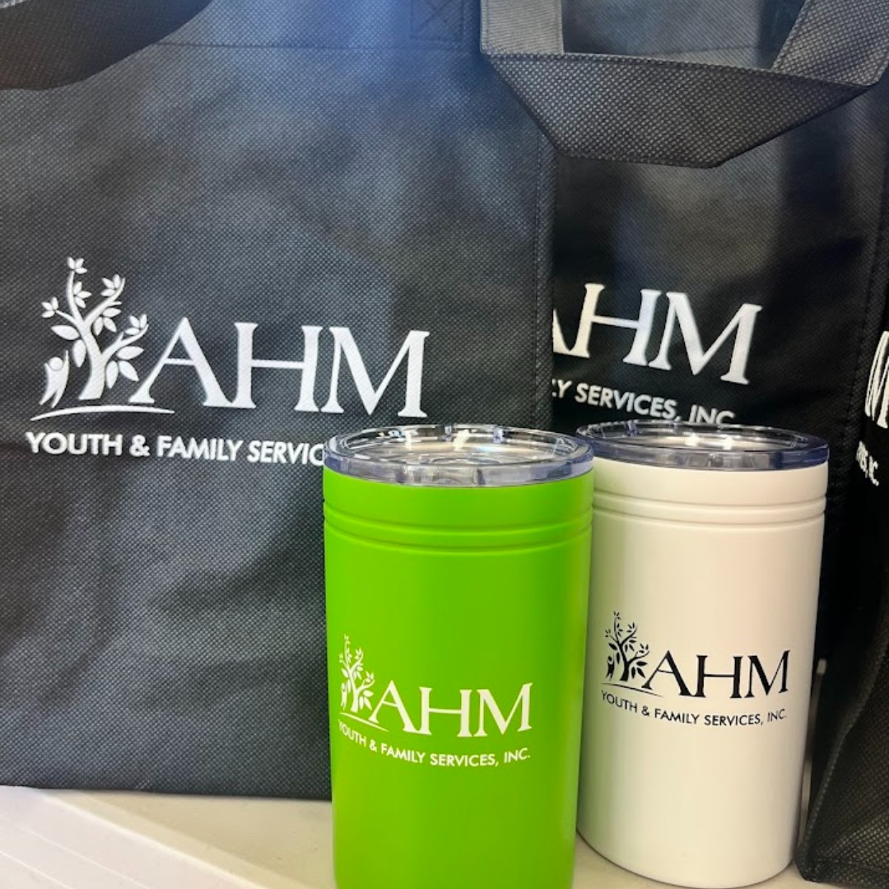
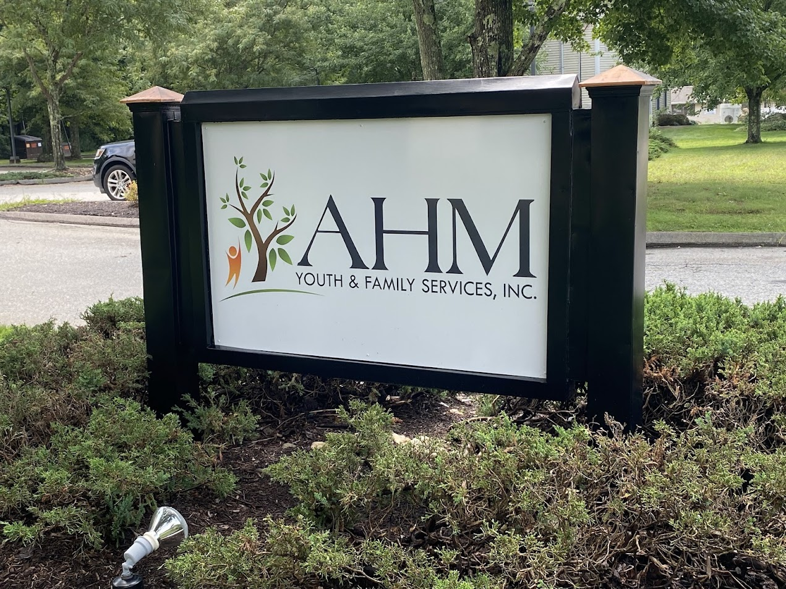
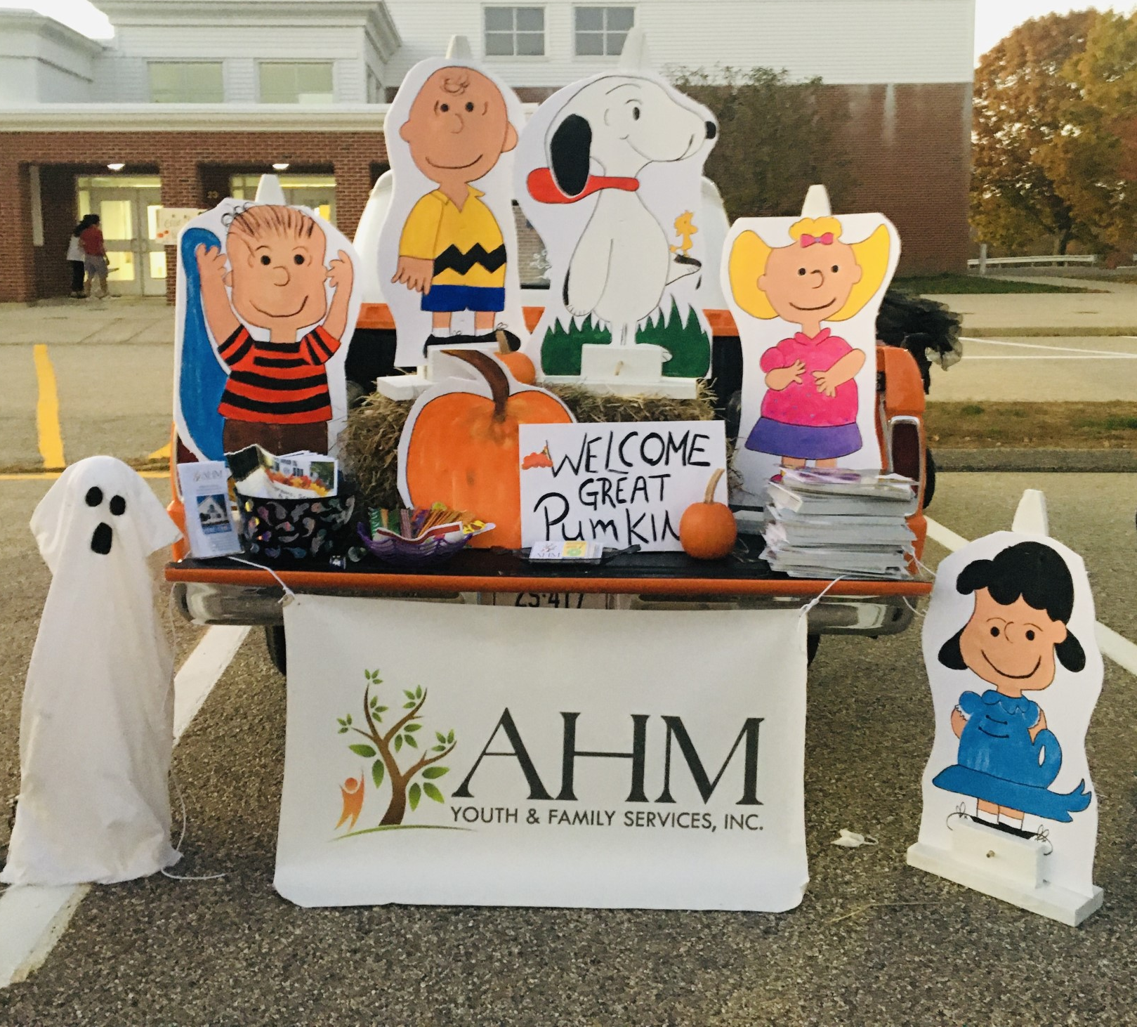
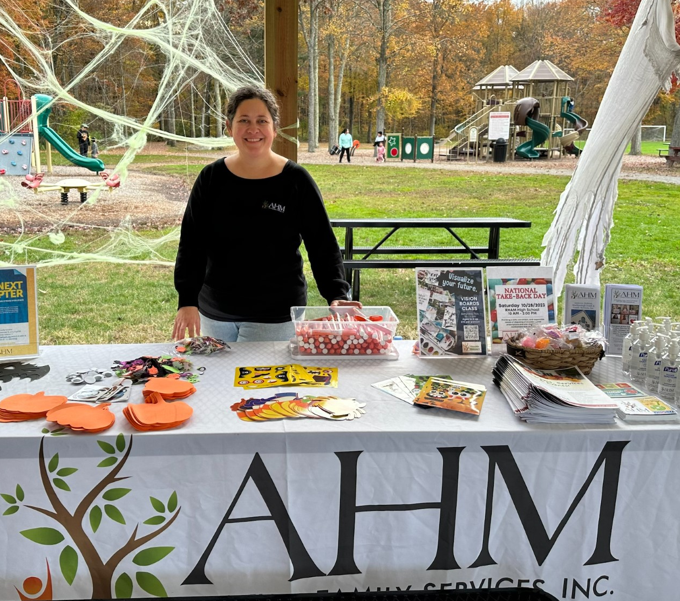

Slide 11
