Slide 1

ACU: YOUTH DEVELOPMENT
CYSA / YSB 101 2024
PYD PLAYBOOK

Slide 2
YSB’s are mandated by CT General Statute 10-19m
A YSB is designed for planning, evaluation, coordination and implementation of a network of resources and opportunities
For children, youth, and their families. YSB’s are responsible for the provision of services and programs
for all youth to develop positively and function as responsible members of their communities.
Some Best Practice Porgrams:
Adventure-Based Activities/Ropes Courses; After-School Programs; Anger Management Groups; Community Service Clubs;
Leadership Programs; Mentoring; Peer Support Programs; Positive Leisure Time Activities; Substance-Free Alternative Activities;
Summer Recreational Programs; Teen Centers; Theatre Troupes; Truancy/Drop-out/Violence/Substance Abuse Prevention
Programs; Wellness Programs; Youth/Adult Partnership Programs; Youth Employment and Job Training, etc.

Slide 3
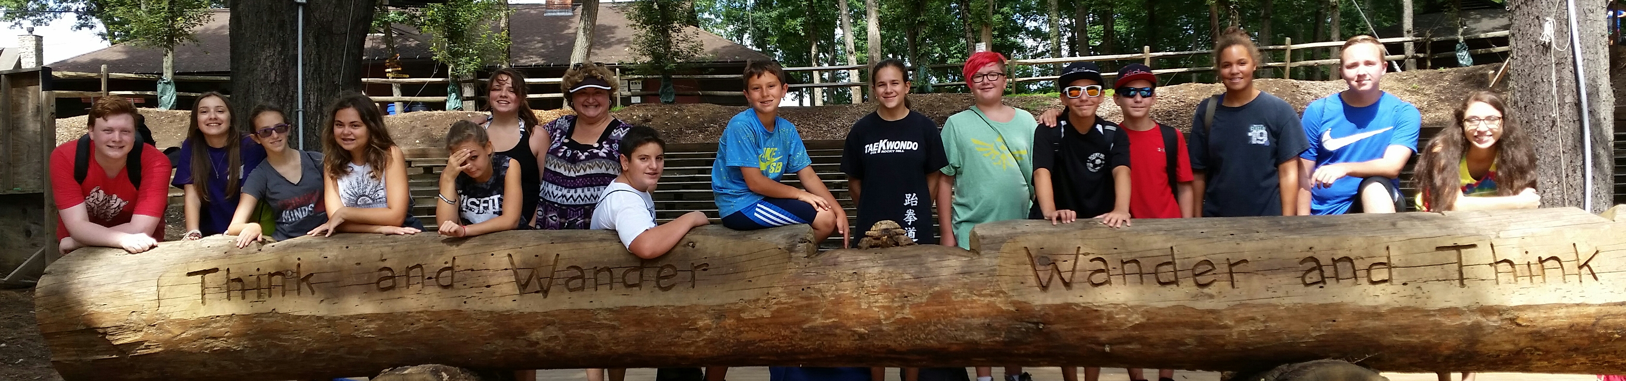
Youth Development
“the ongoing process in which youth are engaged in building skills, attitudes, knowledge & meaningful experiences that prepare them for their present & the future.”

Slide 4
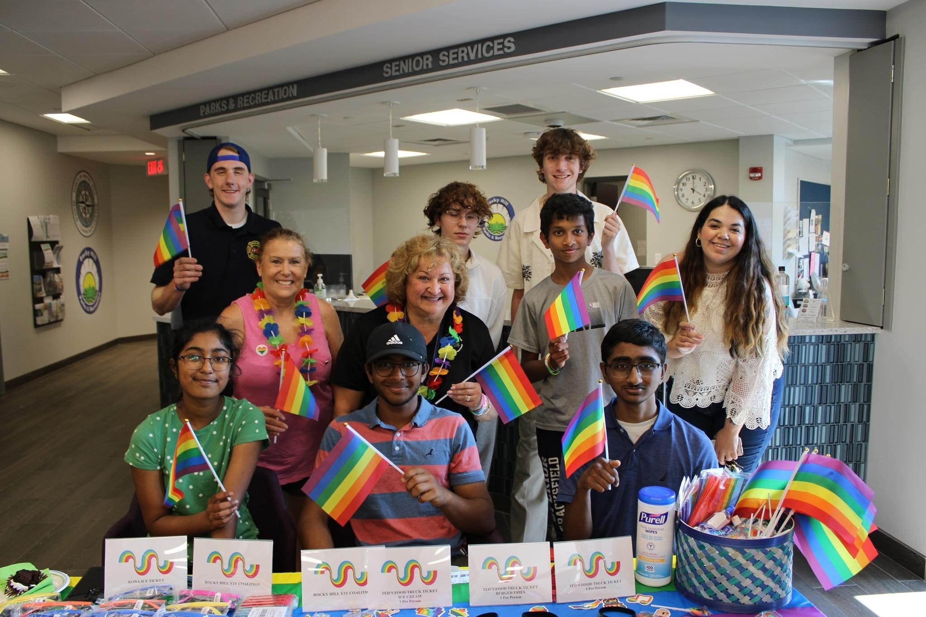
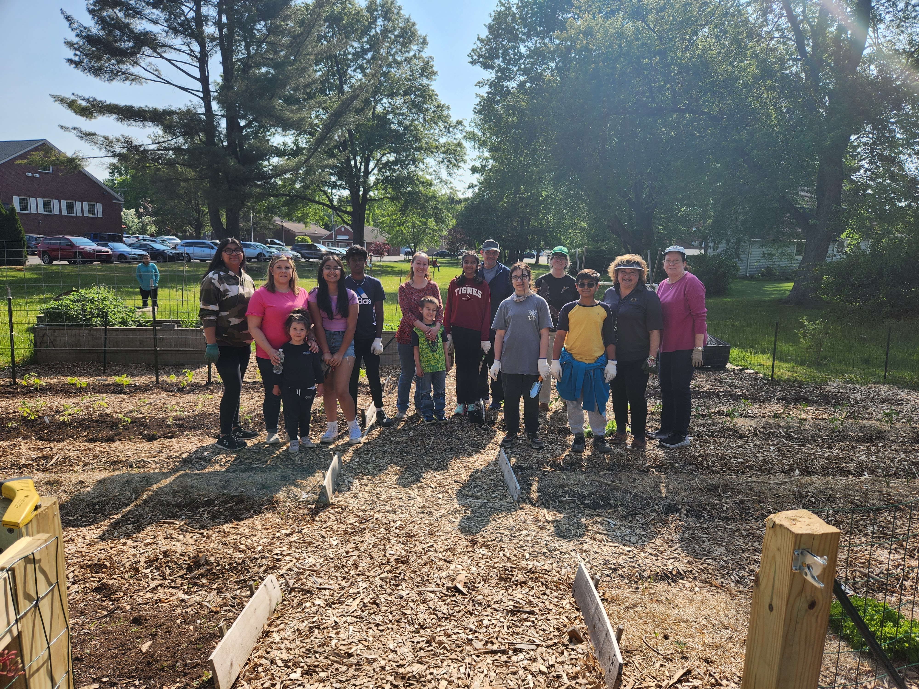
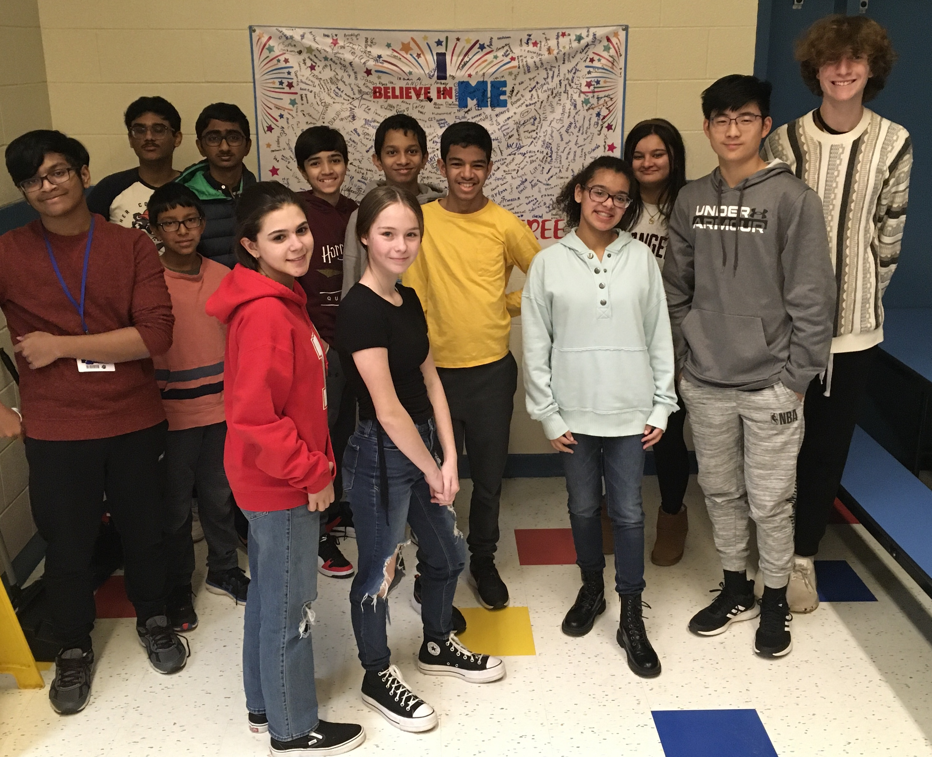
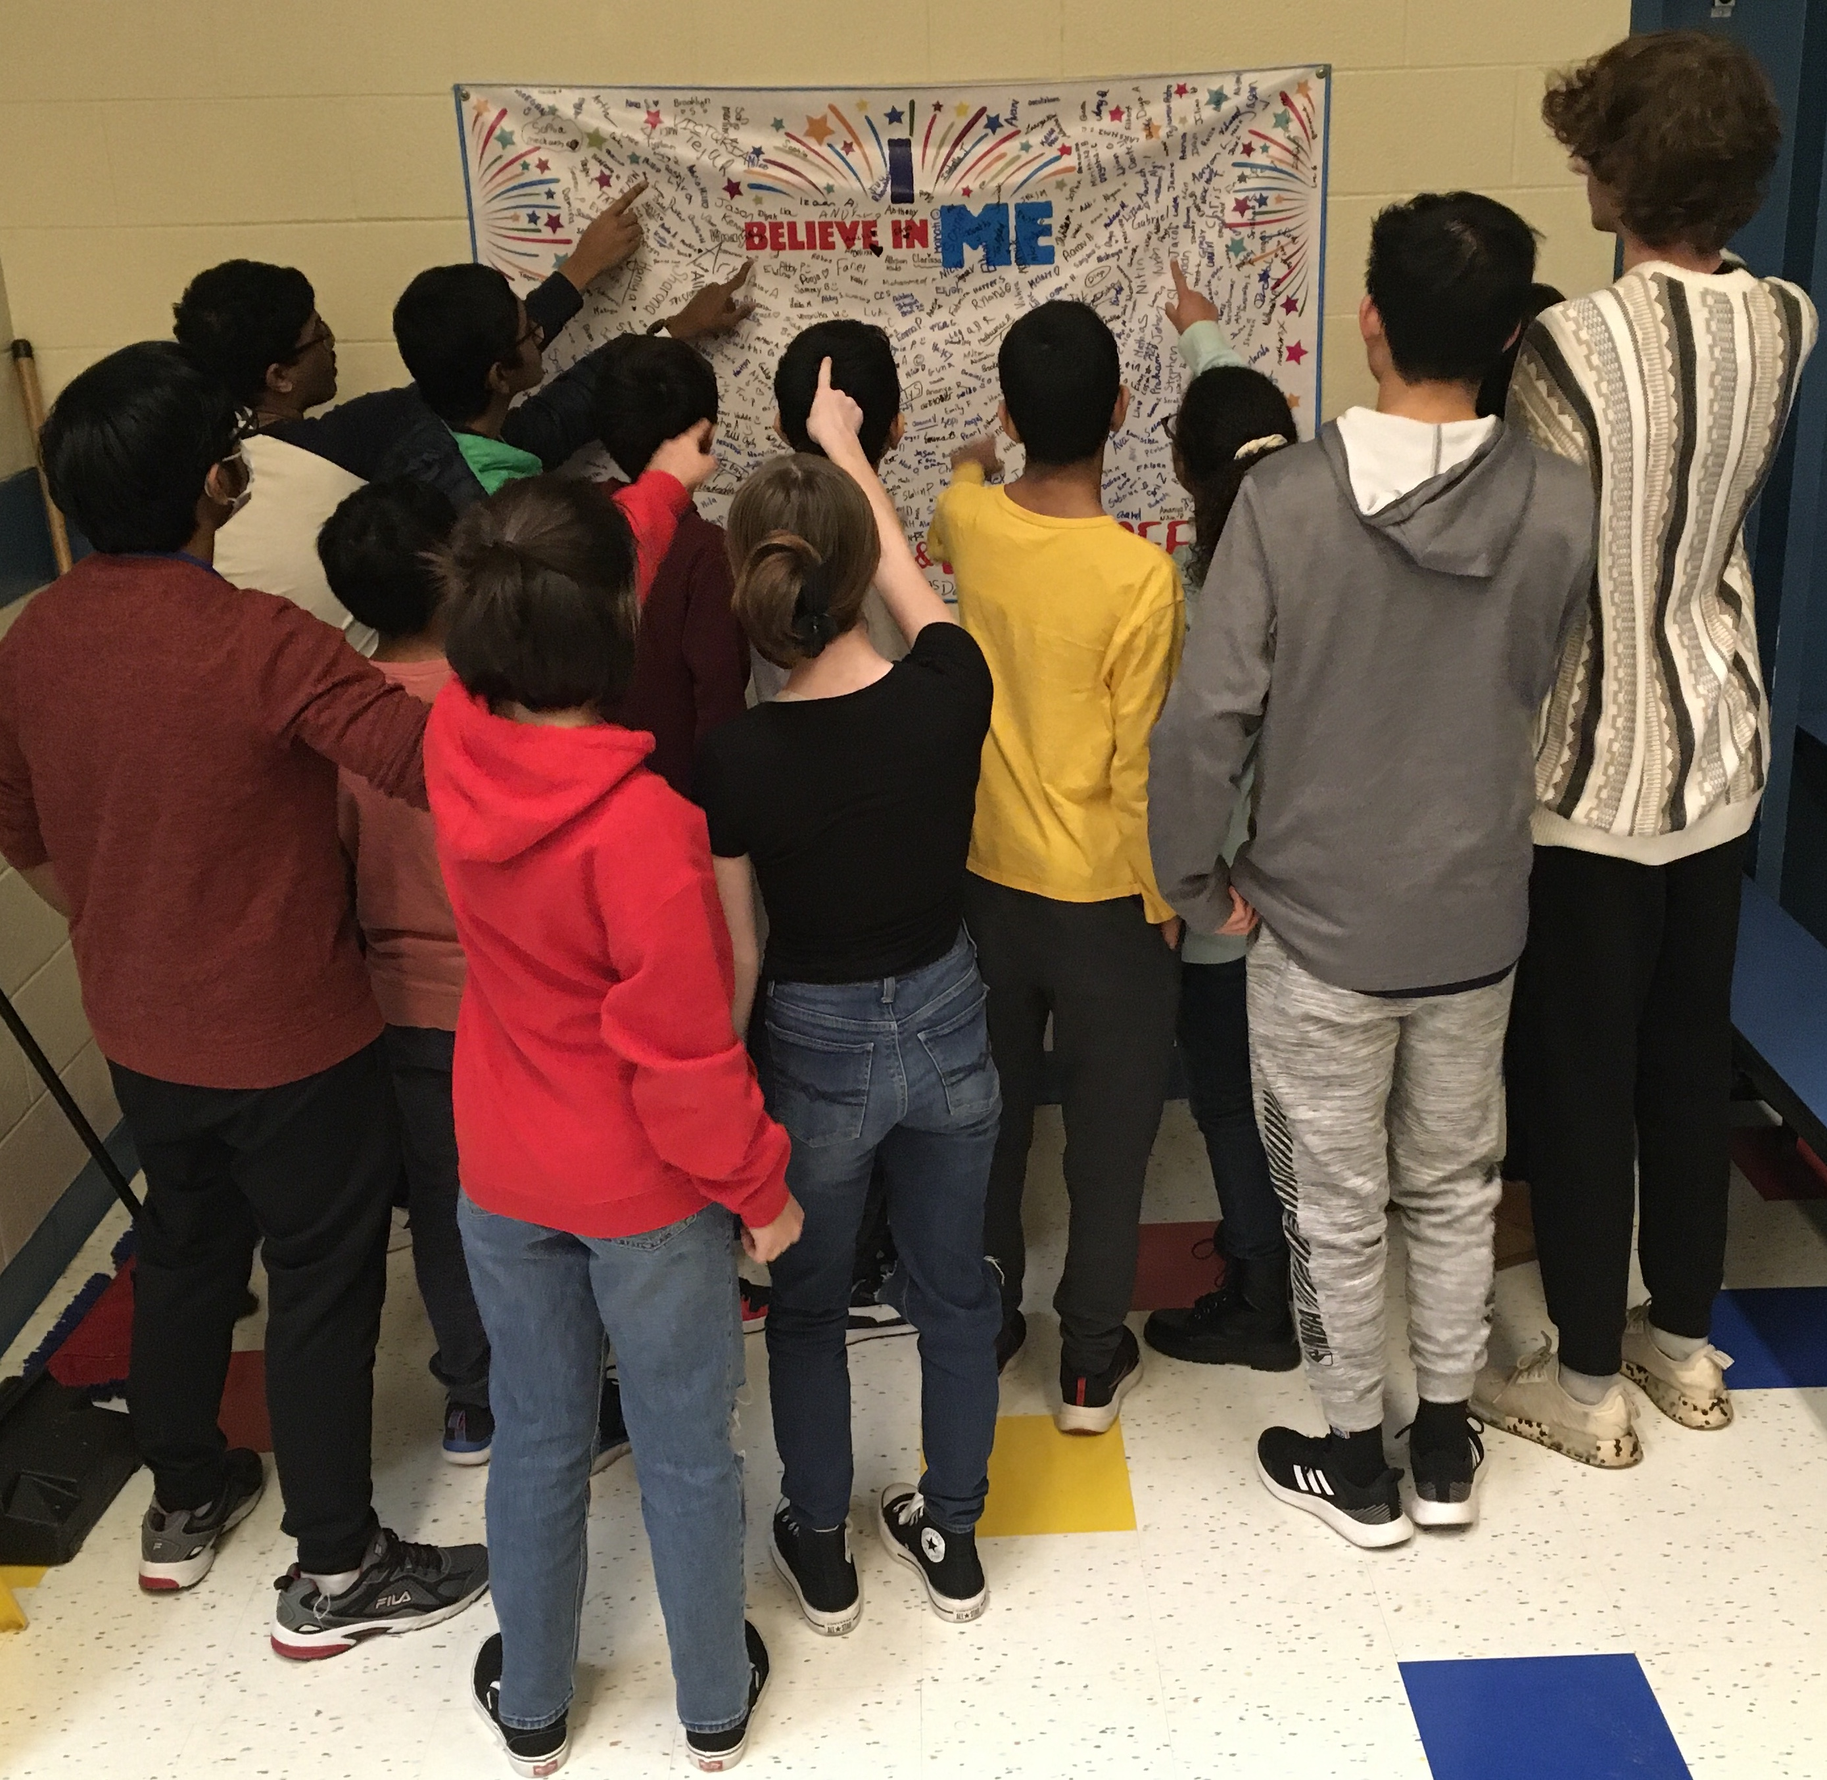
Positive Youth Development (PYD) is crucial for nurturing the potential of young people. It involves empowering them to maximize their full potential. Here are some key reasons why PYD MATTERS:
  Identity and Belief in the Future
  Self-Regulation and Self-Efficacy
  Social and Emotional Competence
  Cognitive and Behavioral Competence
  Protective Factors: resilience and bonding
  Reducing Risk Behaviors: such as substance use, violence and sexual risky behaviors
Positive Youth Development provides a holistic approach to nurturing youth potential, fostering resilience and creating a supportive environment for their growth.

Slide 5
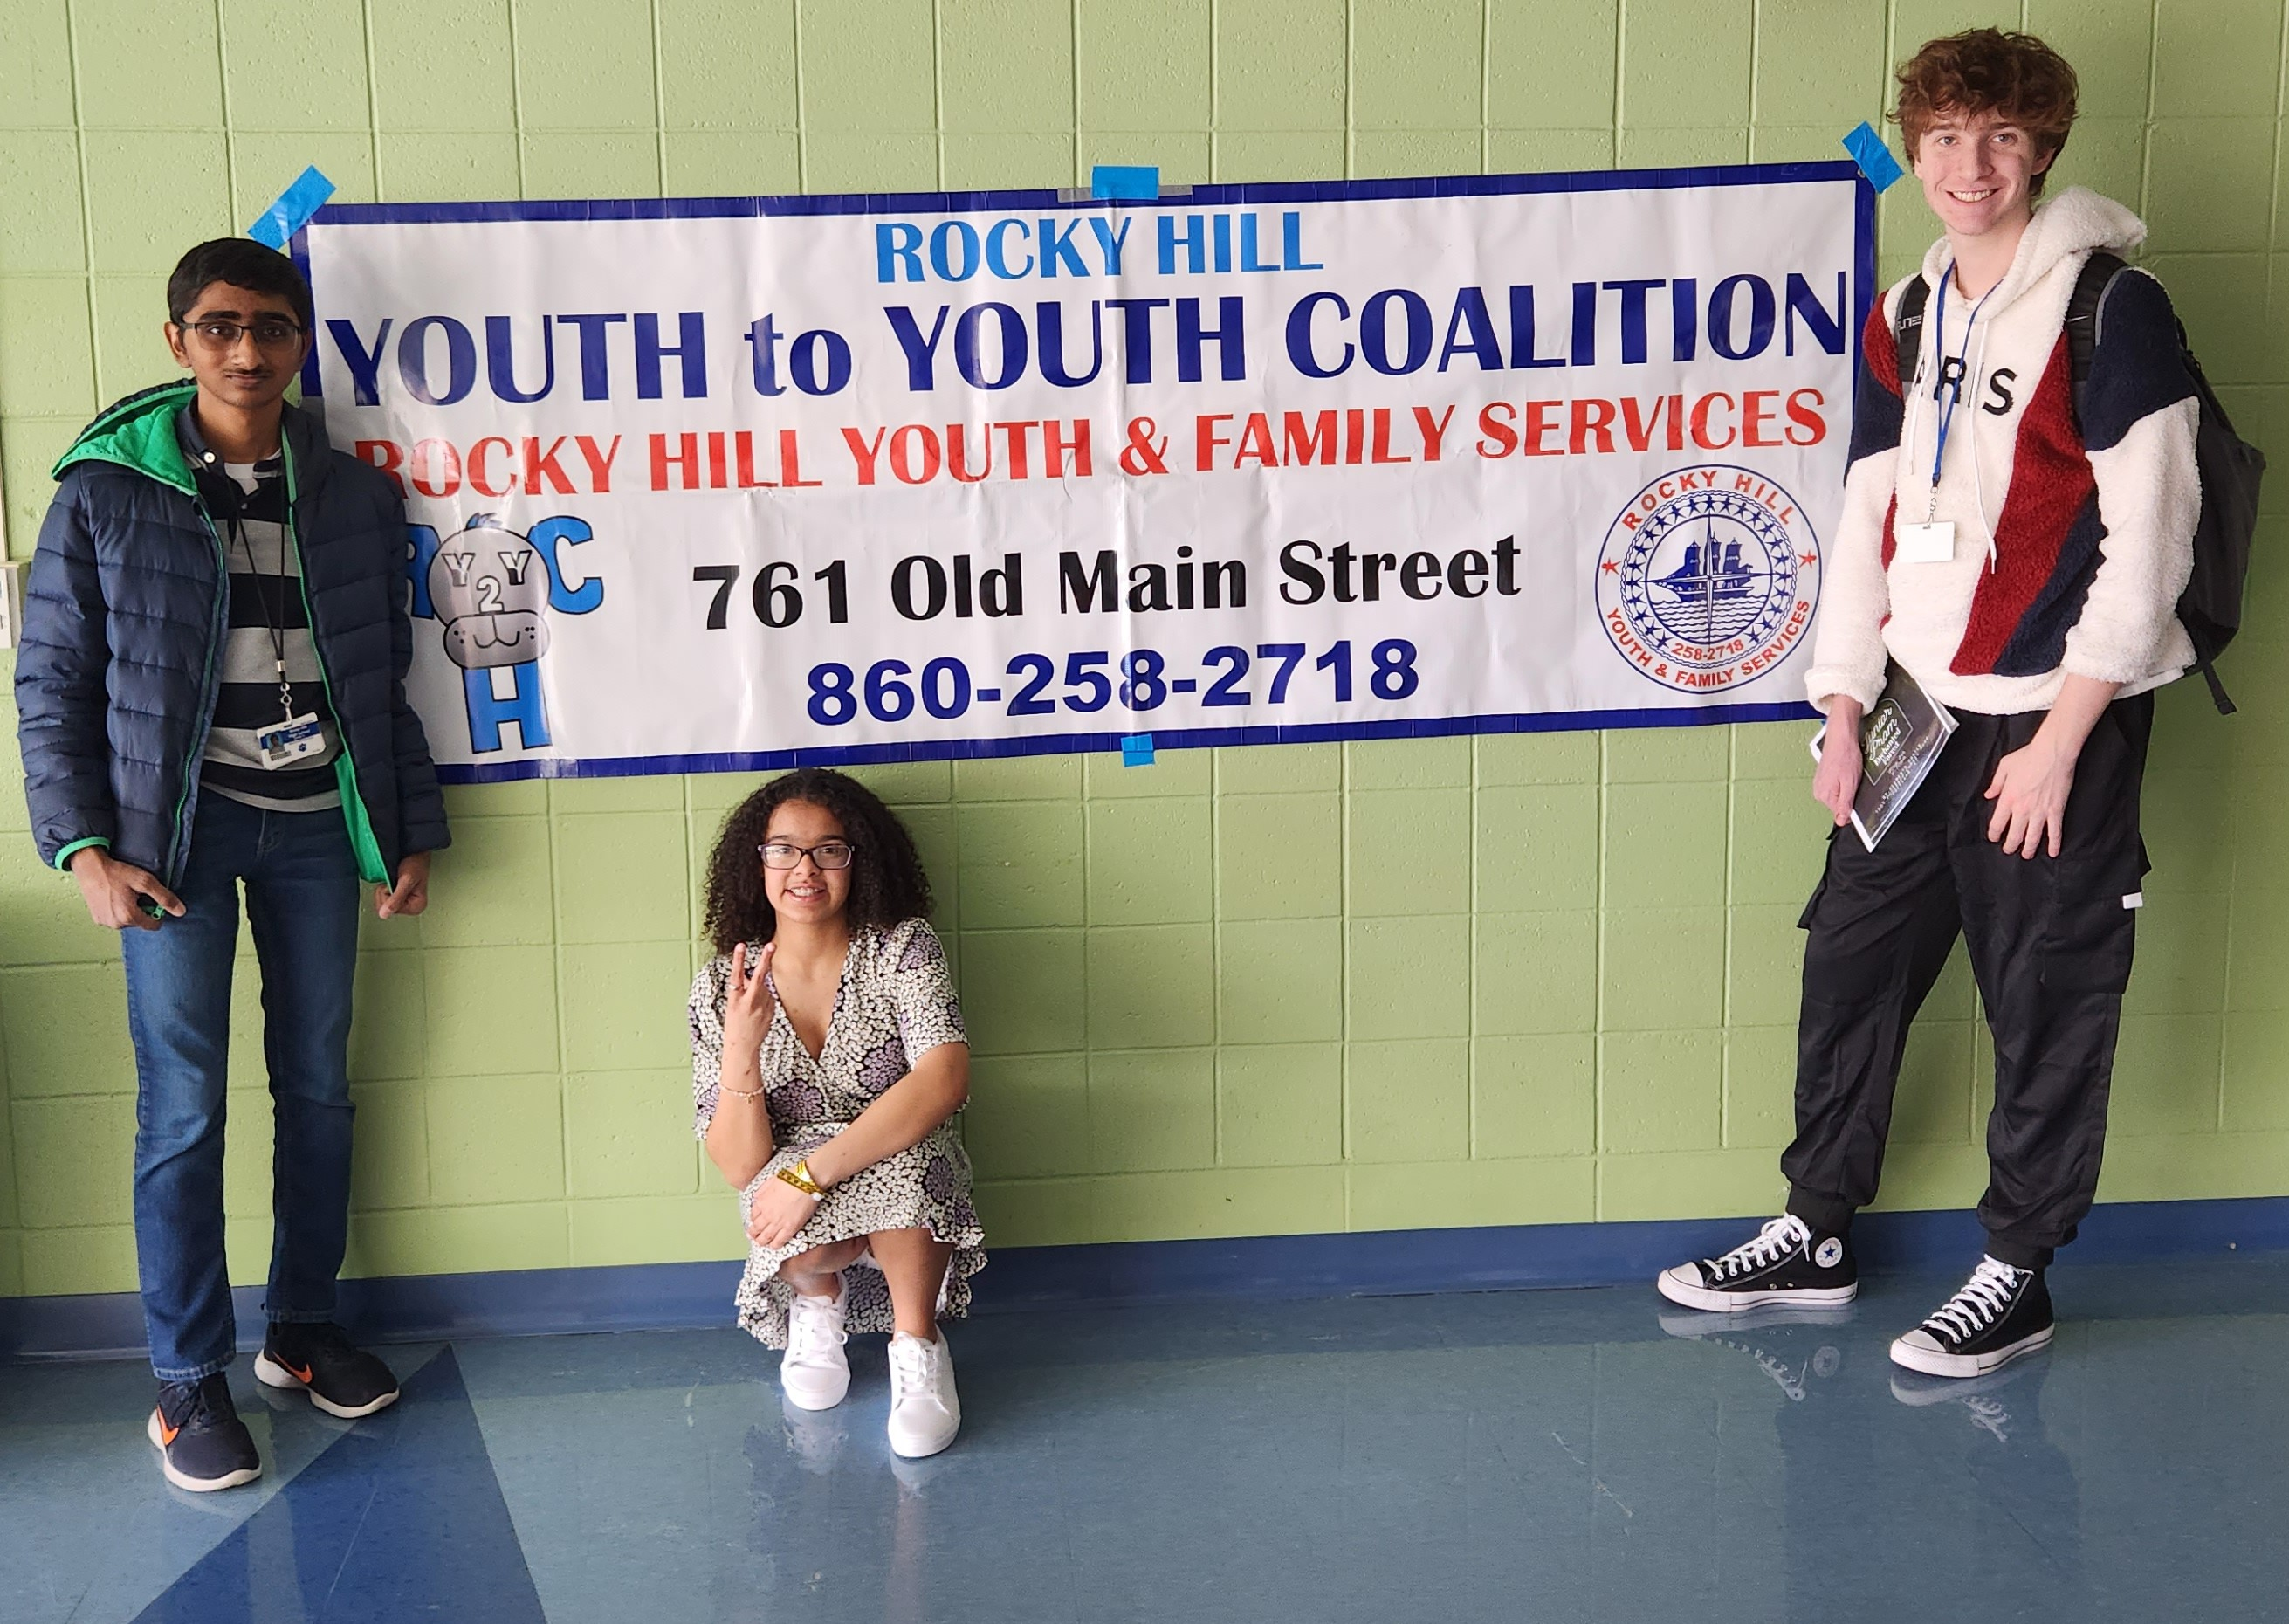
Best Practices for Youth Programming
* Appropriate Structure - Youth Led/Adult Mentored
* Supportive Relationships - variety of mentors
* Physical and Psychological Safety - Comfortable, safe space, food/drink
* Opportunities to Belong - Youth positions/roles/responsibilities/SWAG
* Positive Social Norms - Group Rules
* Support for Efficacy - Goals/Objectives
* Opportunities for Skill Building - Speakers
* Integration of Family, School & Community Partners

Slide 6
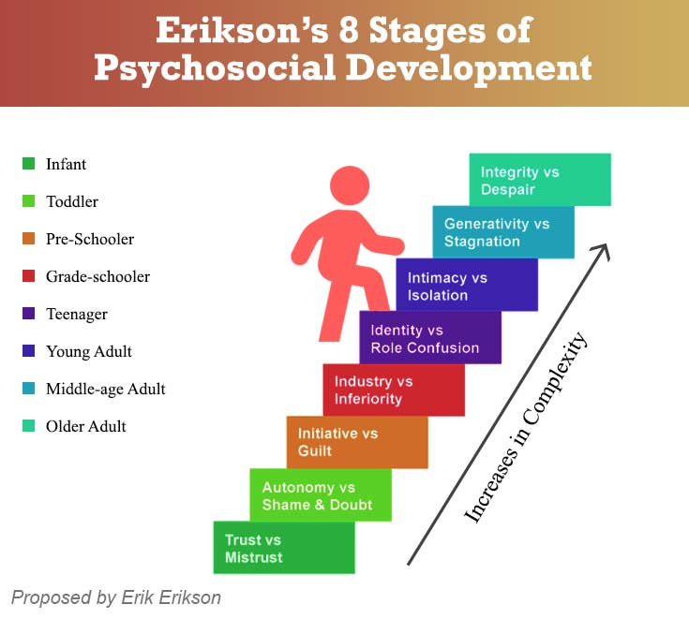
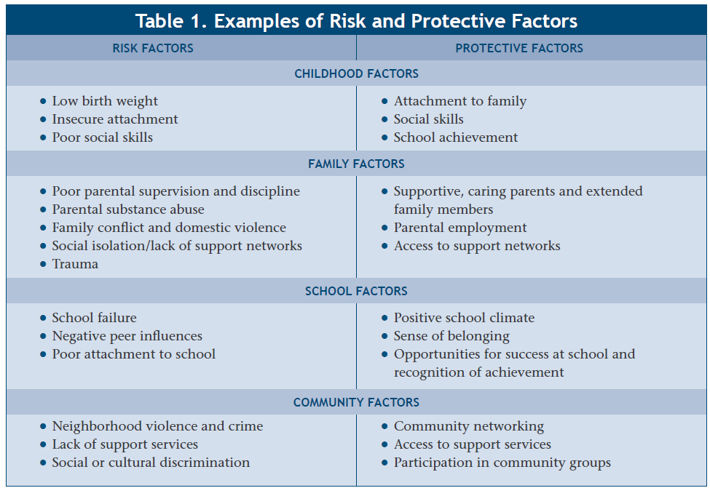

Social Development Model:
This theory organizes the evidence regarding risk and protective factors for delinquency and substance abuse by hypothesizing the theoretical mechanisms through which these factors operate to increase or decrease the likelihood of antisocial behavior.
Identify risk/protective factors & foundation building with our partners:
  Families, /Friends
  Schools/Staff/Peers
  Community Organizations
  Businesses
Slide Credit: Deb Stewart

Slide 7
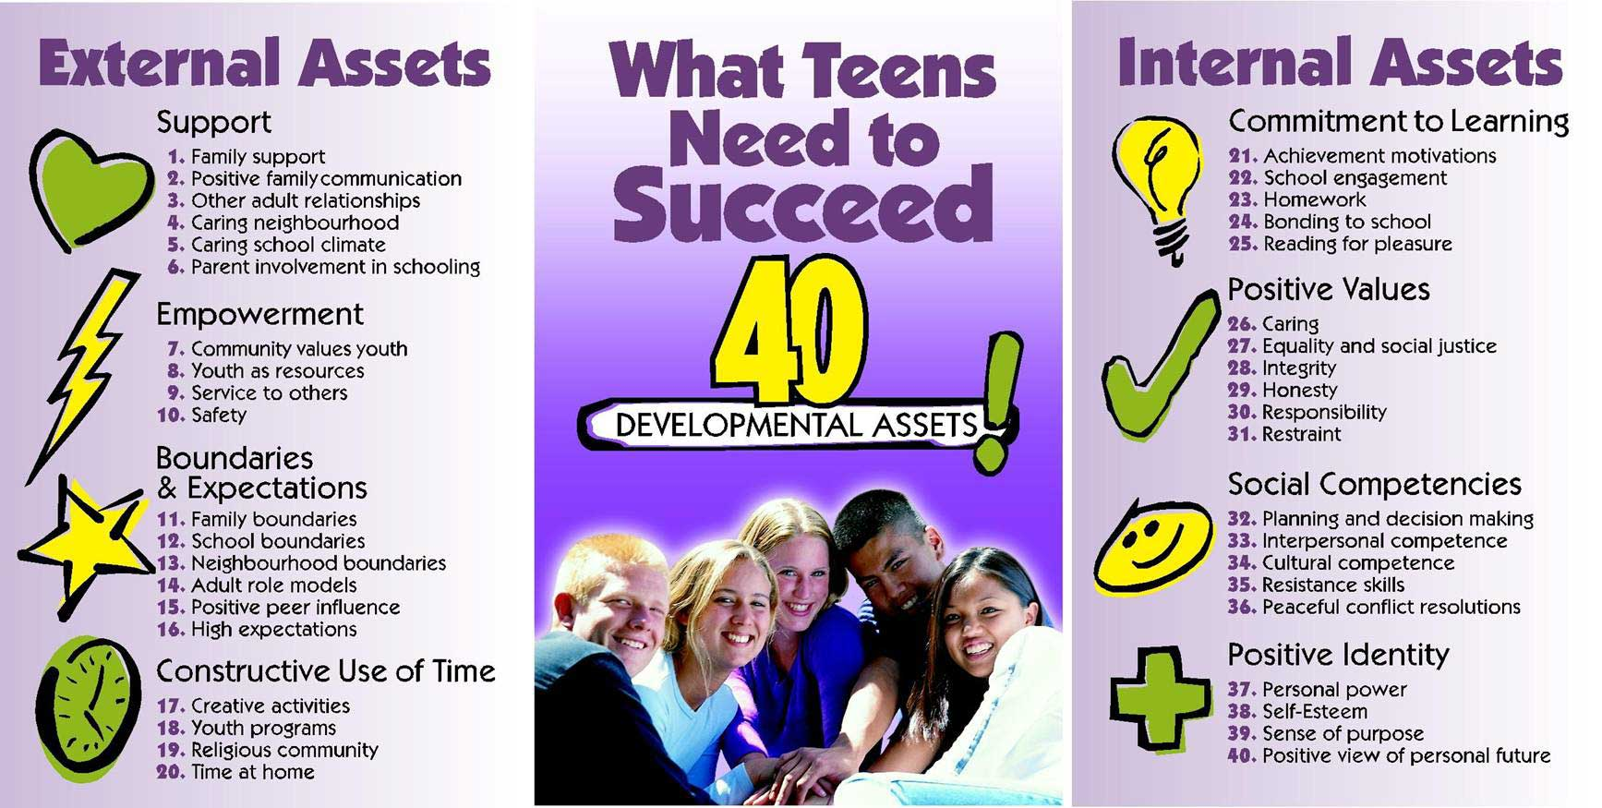
Assess:

Slide 8
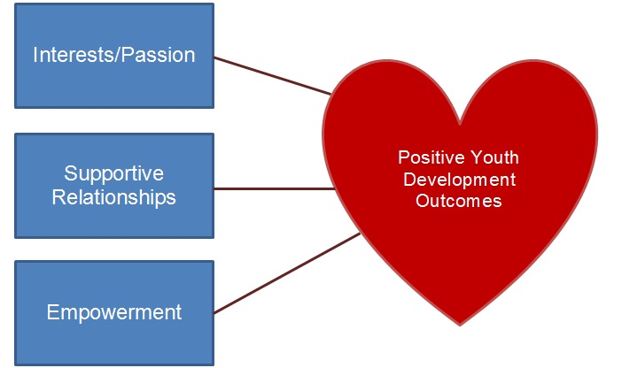
The Power of Collaboration: Elevating Student Connection and Voice
The Positive Youth Development Process:
Community Needs Assessment
Think Tank with Key Stakeholders
Creative Ideas Selected
Opportunities for Youth to Work with Adults
Provide Leadership & Education
Evaluation

Slide 9
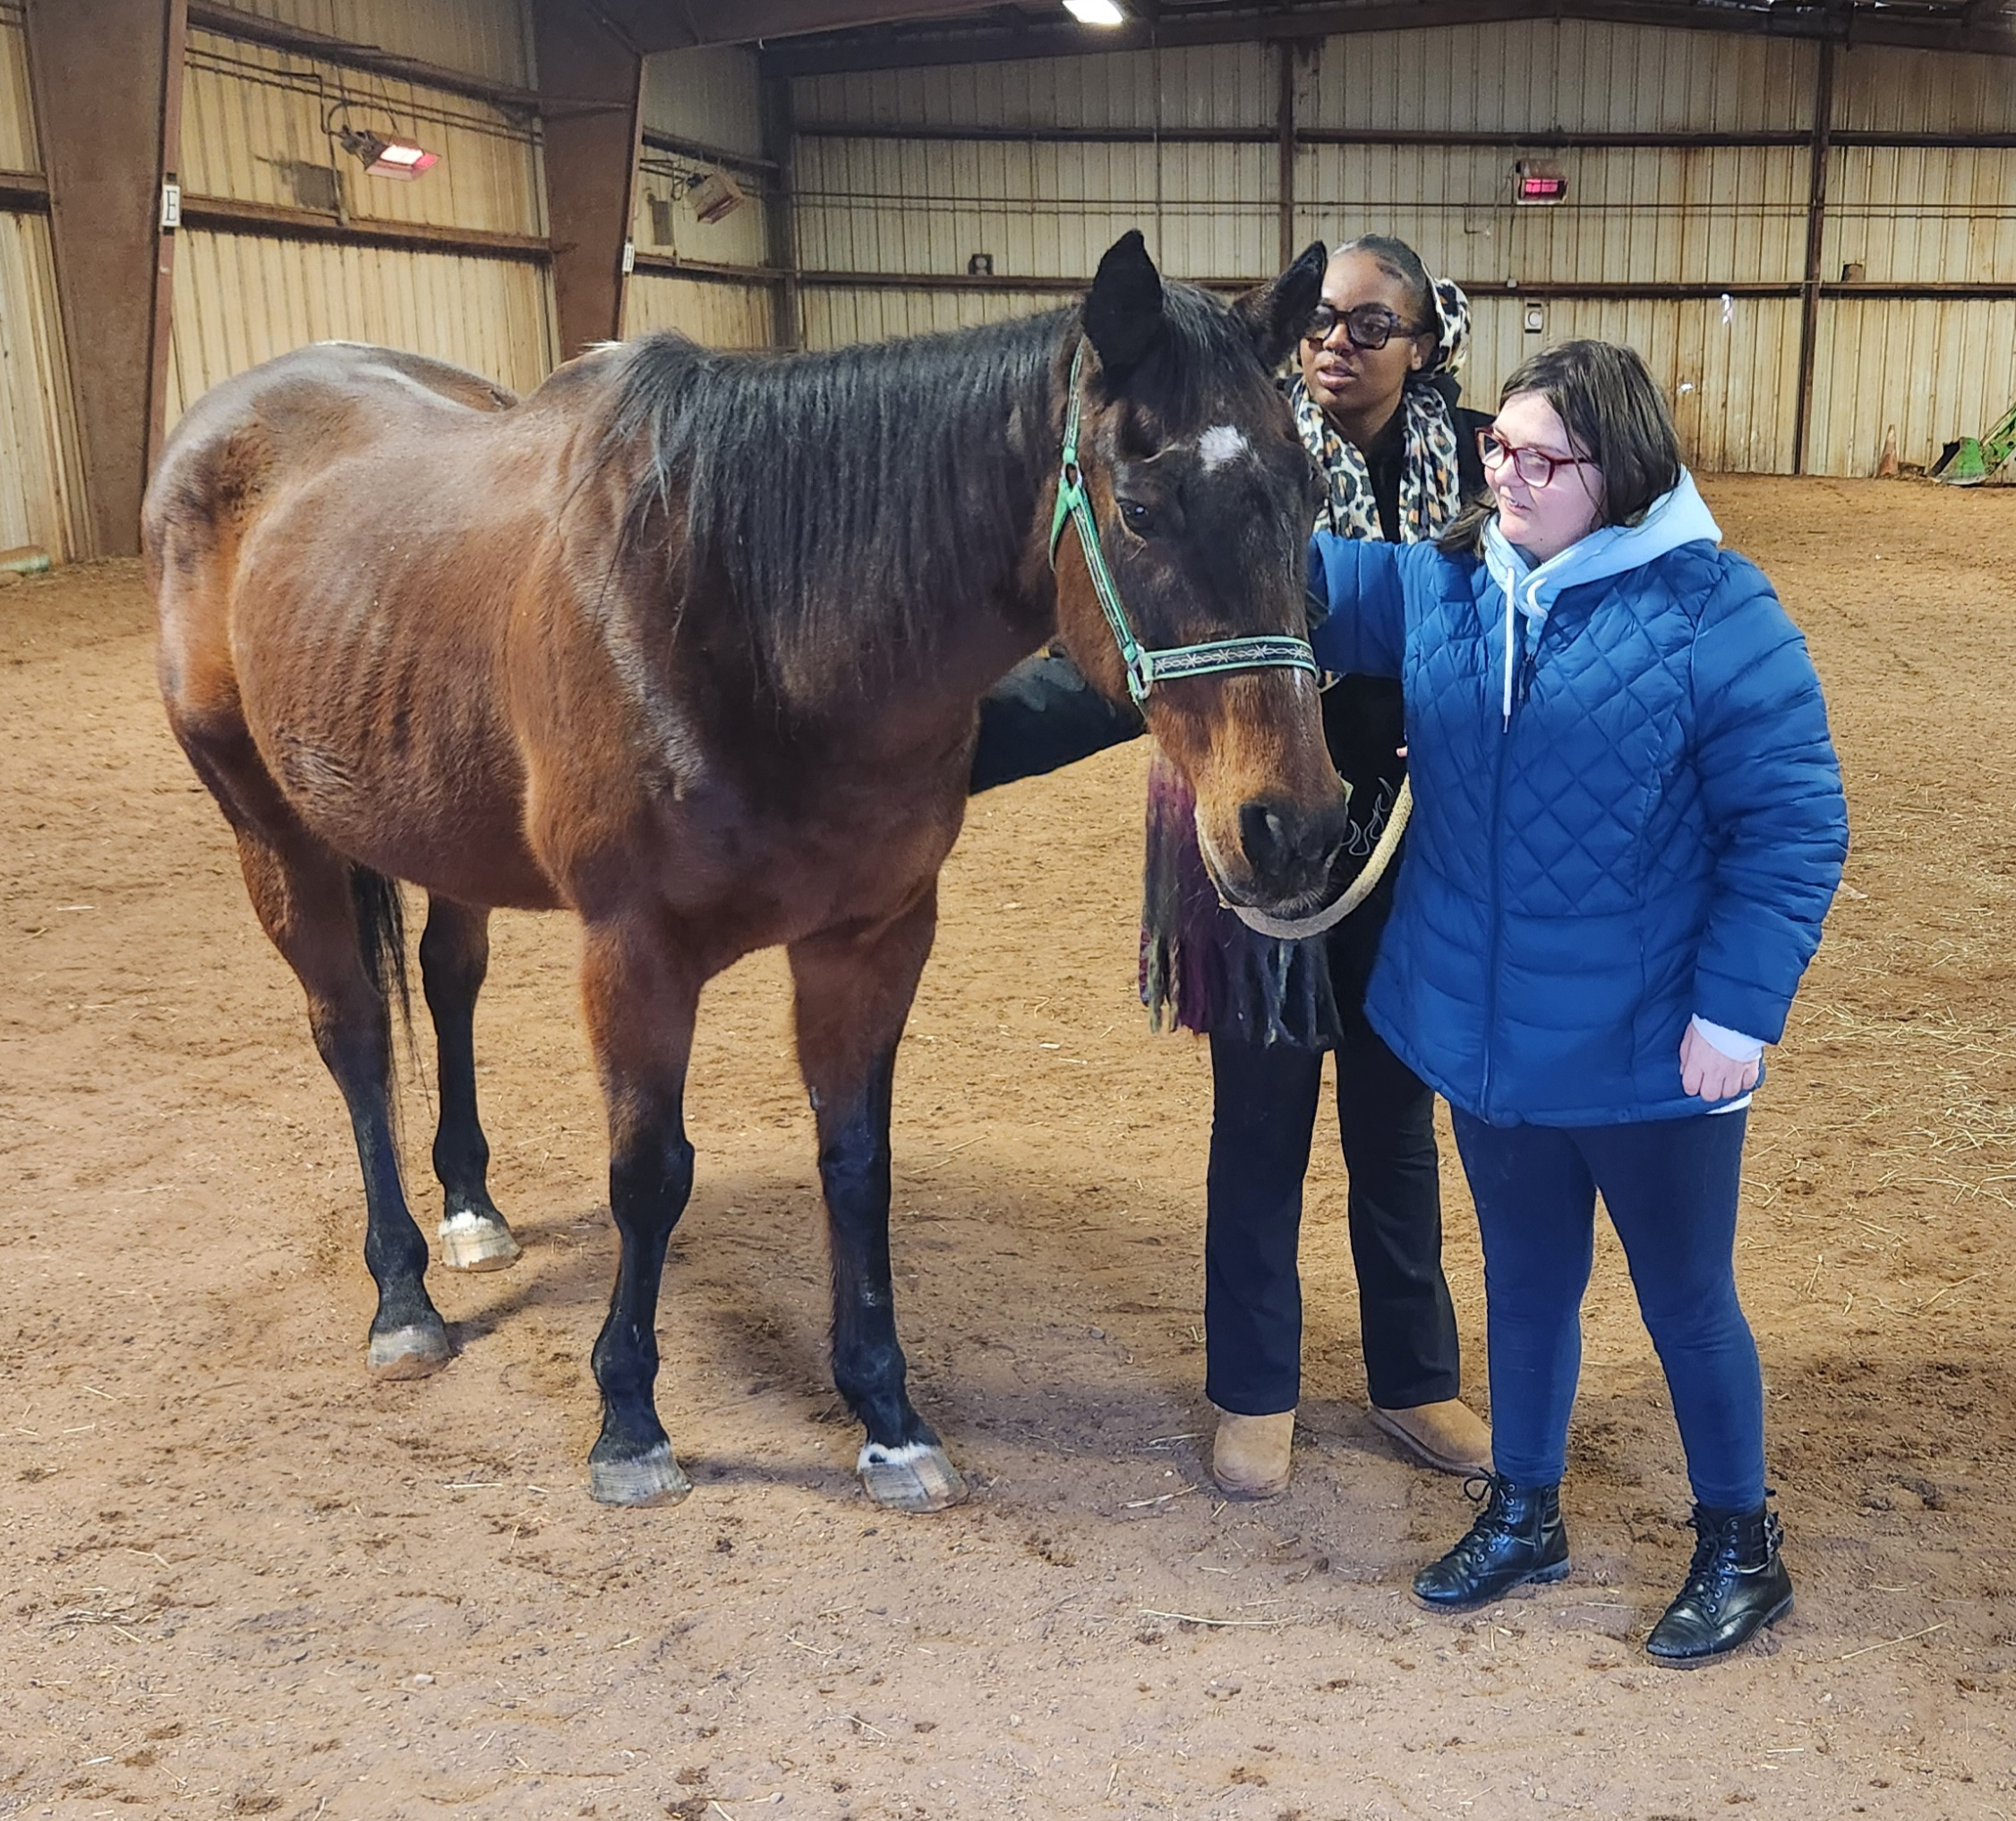
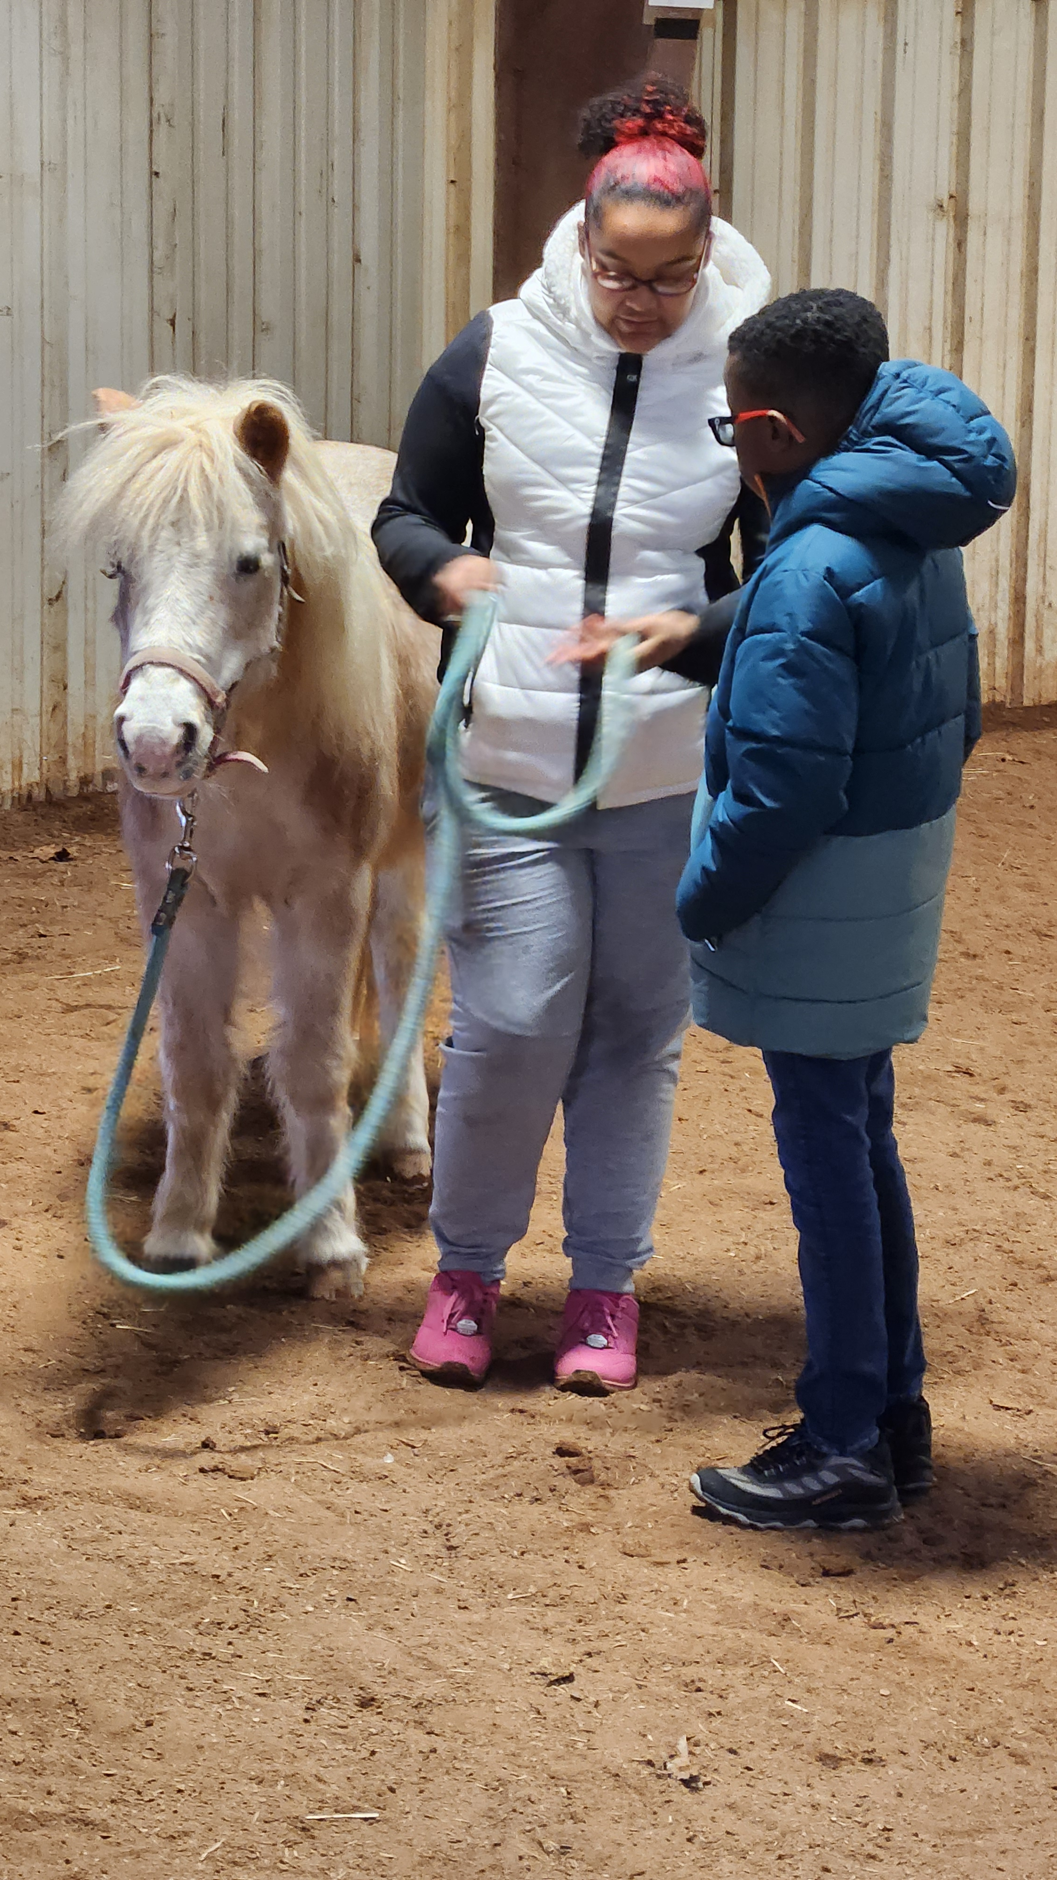
Equine Experiential Learning
A new positive youth development
program based on our community needs assessment which focused upon neurodivergent youth needs.
Horse & Human Connections

Slide 10
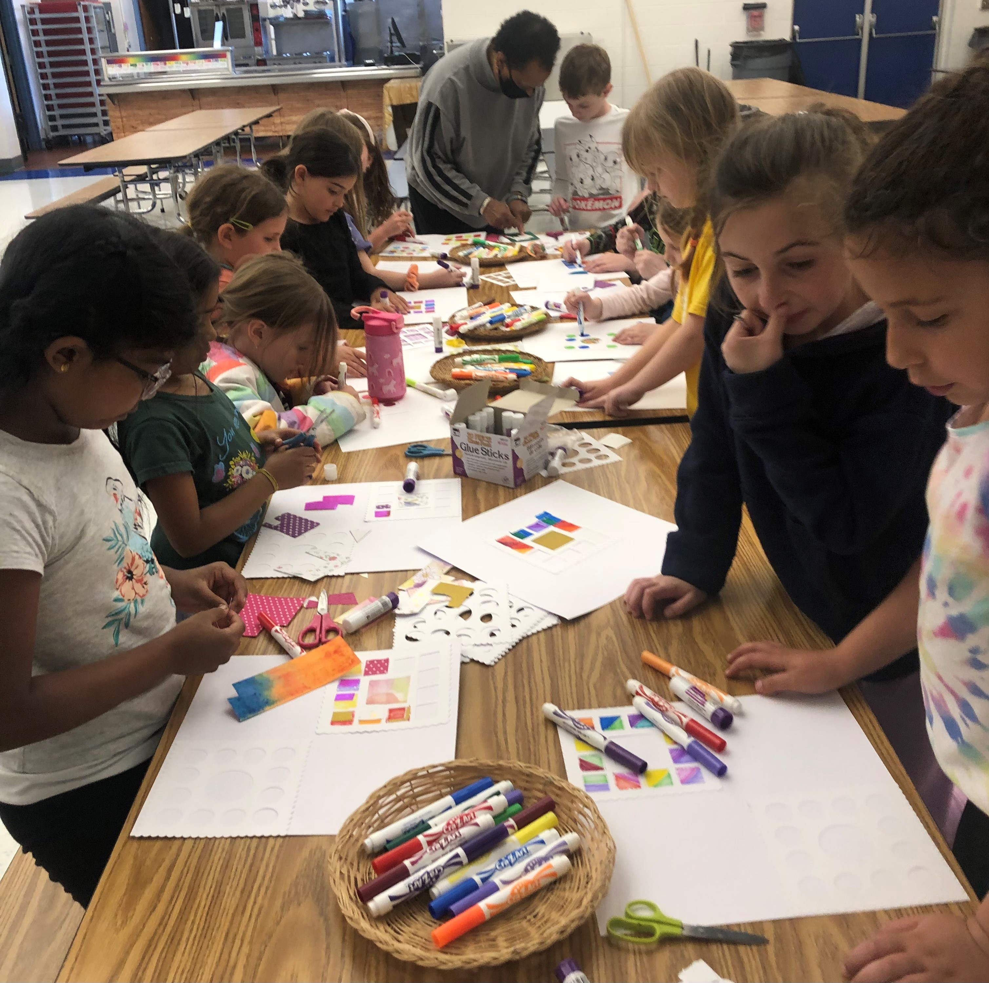
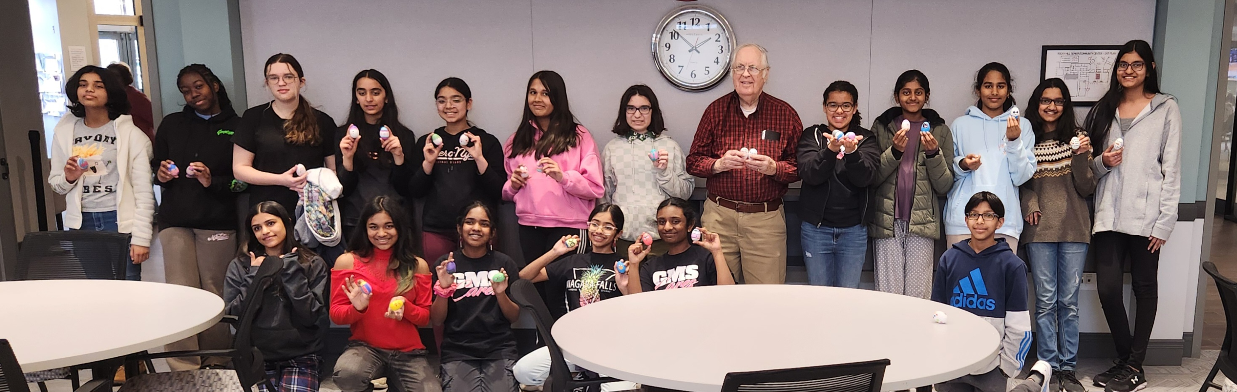
Intergenerational Creativity & Collaboration

Slide 11
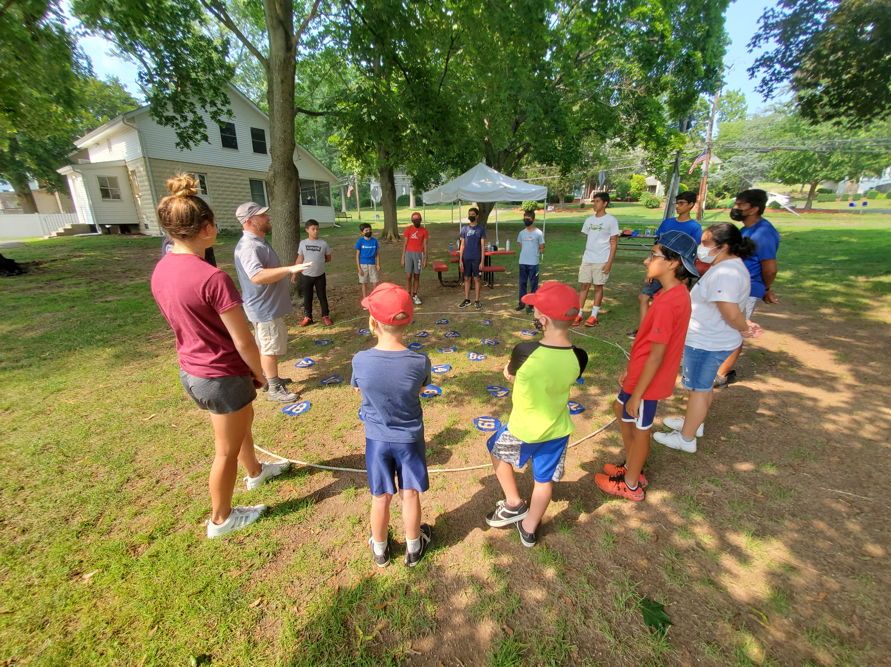
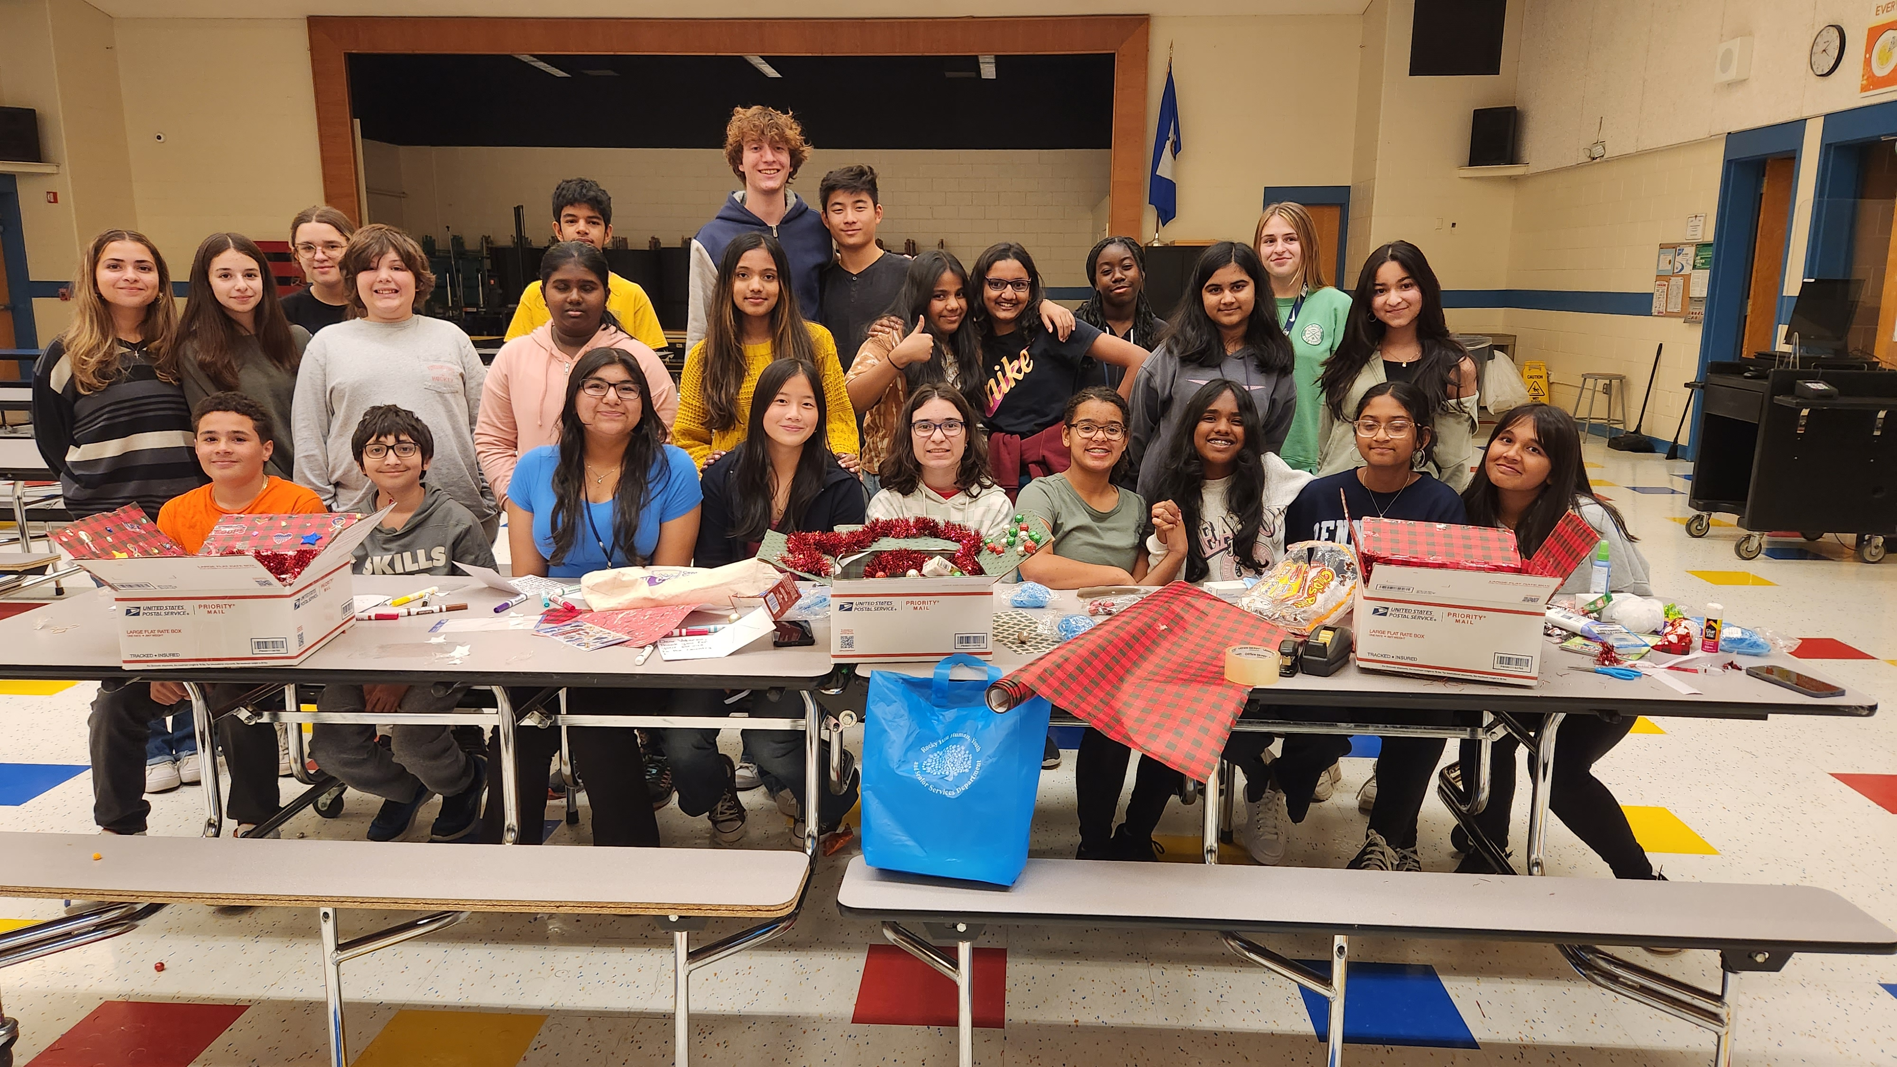
INFUSING FUN Into community WORK VIA Adventure, TEAM BUILDING, LEADERSHIP OPPORTUNITIES, FOOD, field TRIPS, community service hours, internships, helps to promote consistent attendance & productivity

Slide 12
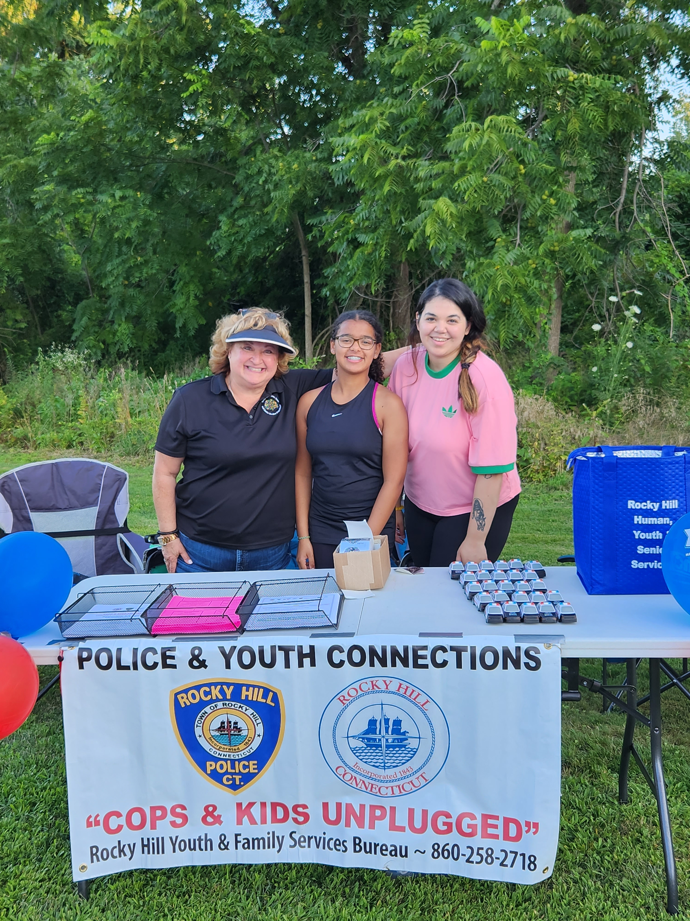
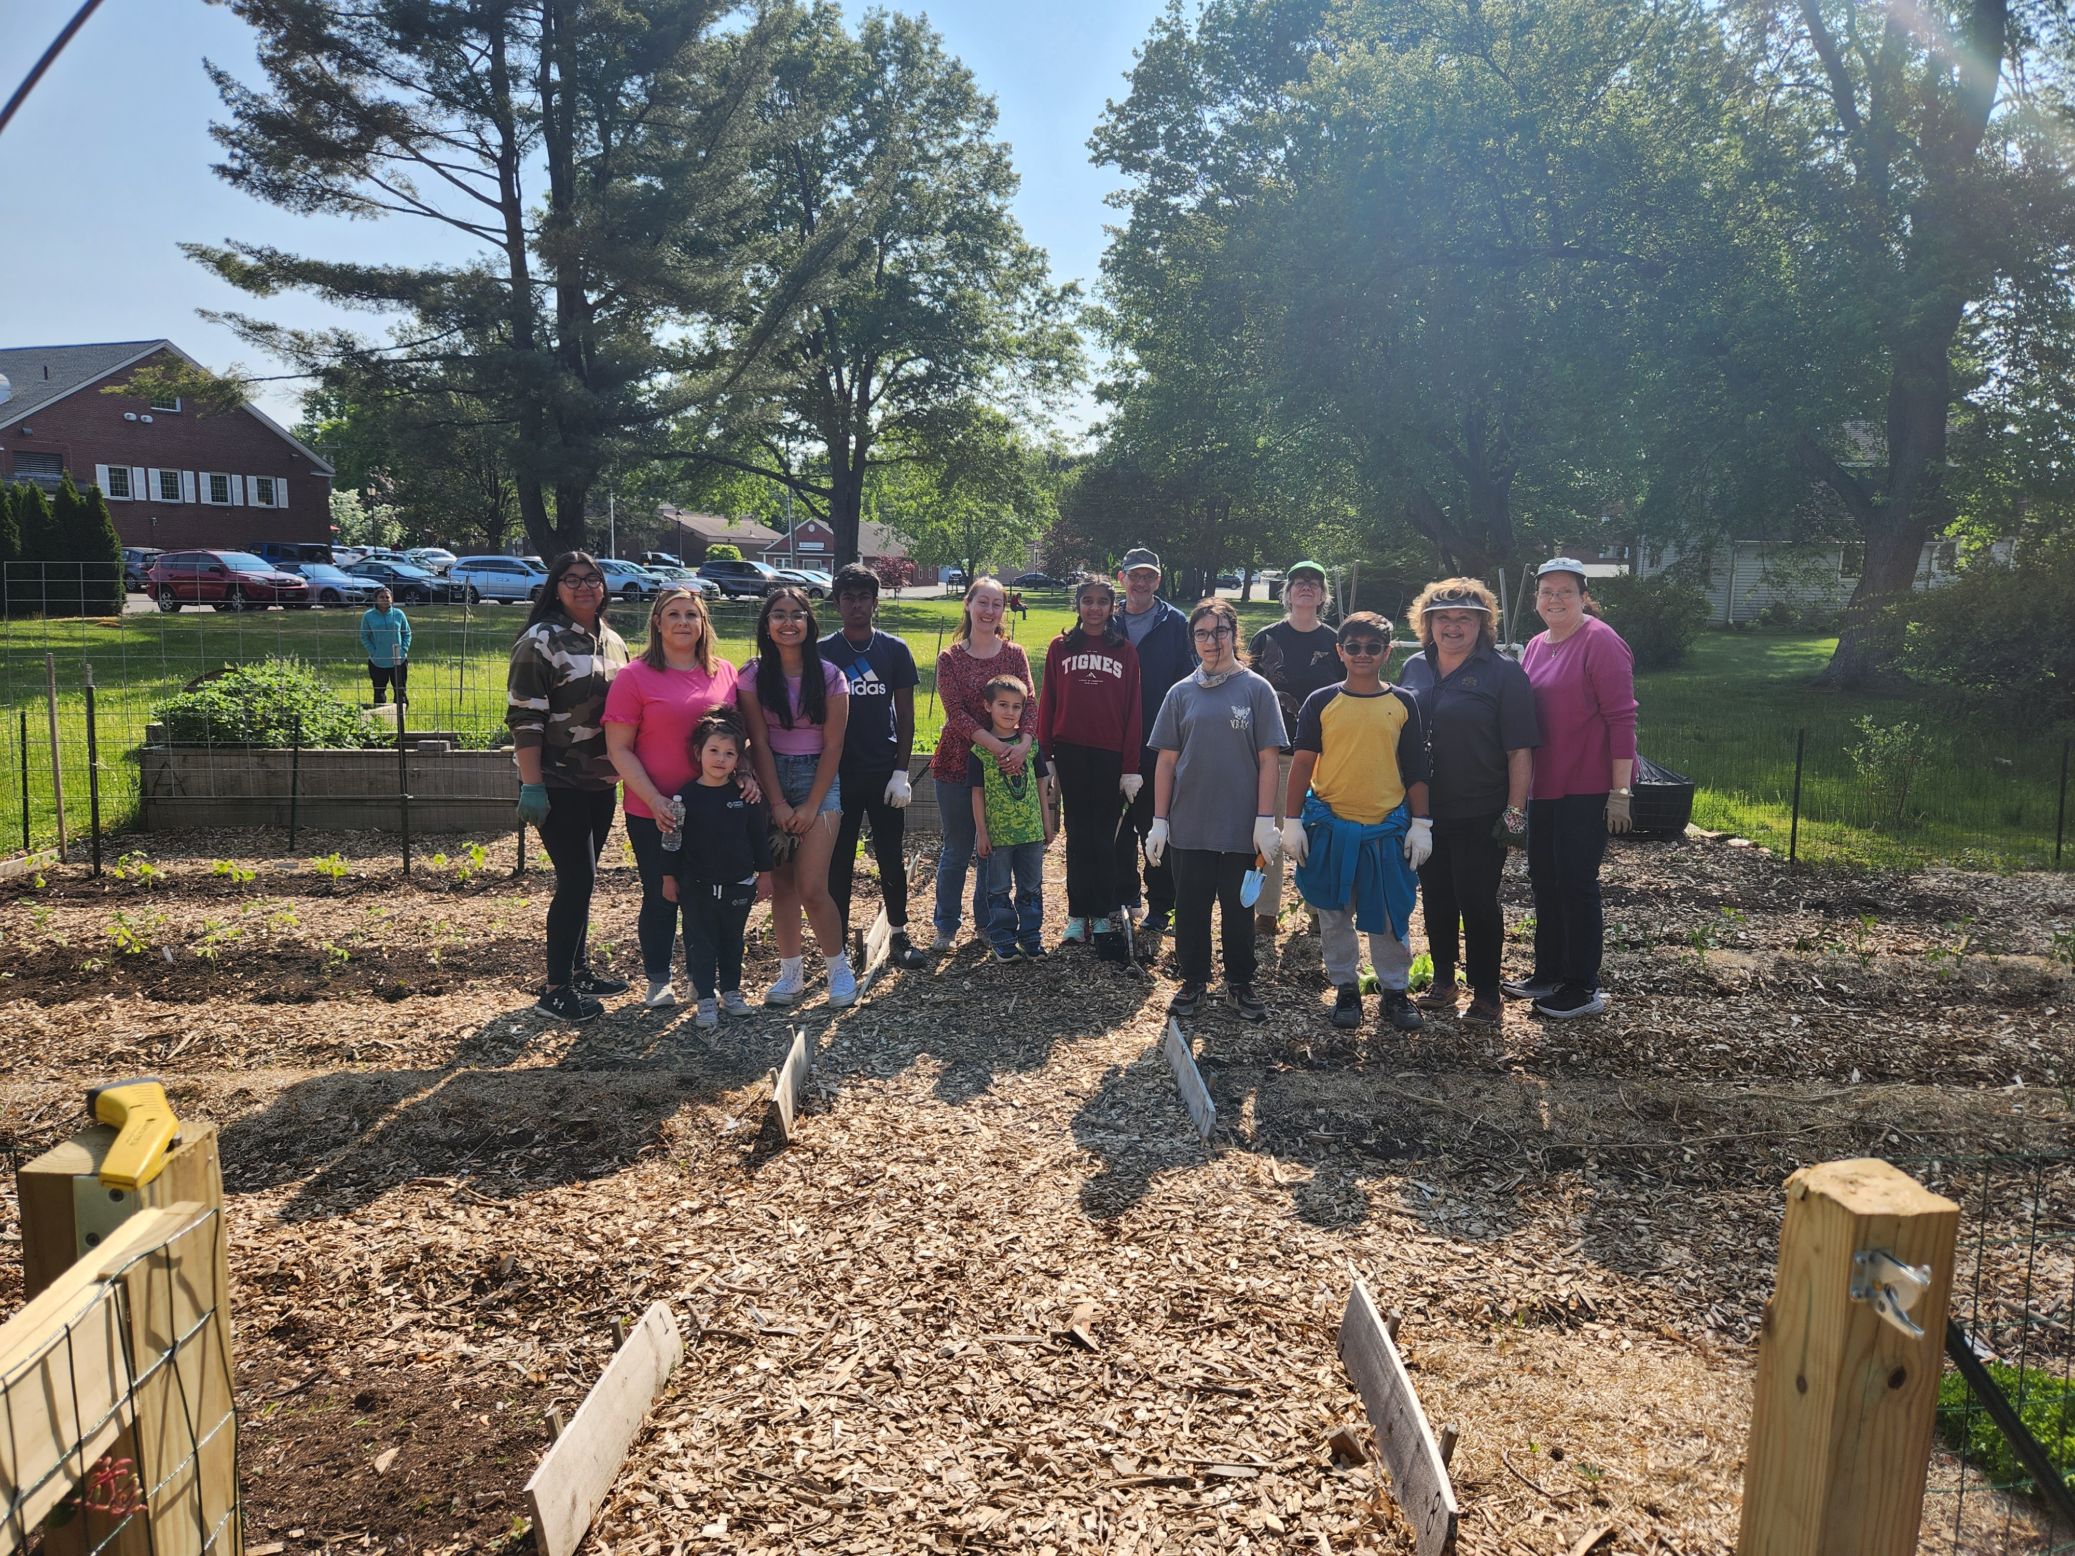
How do youth help your community? How does your community view youth voice & engagement?

Slide 13
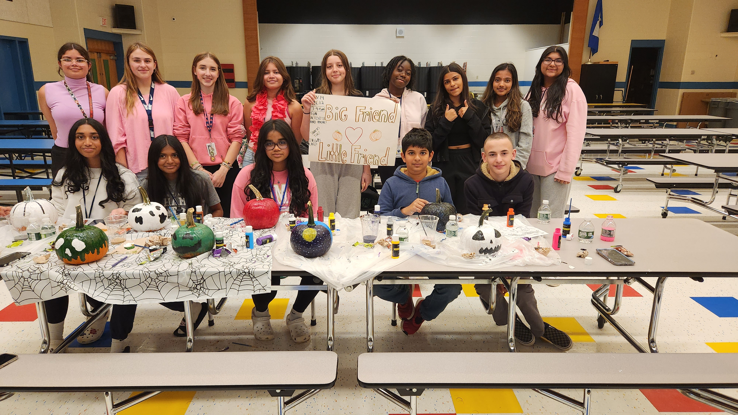
Thank-you for empowering youth to have a voice in your community!
See you at the CYSA Annual Conference October 18, 2024 @ the CT Convention Center

