Slide 1
Juvenile Justice, Diversion & Status Offense Referrals
ERICA BROMLEY
YOUTH JUSTICE CONSULTANT
CT YOUTH SERVICES ASSOCIATION

Slide 2
Juvenile Justice Reform
Juvenile Justice and Diversion
  Research shows that any involvement with the justice system is detrimental to a young person and increases the likelihood that they will re-enter the system at a later date
  System involvement can be at the police level and up through court and beyond
  Goal is ultimately to divert youth from any kind of system involvement (even with another agency like DCF)
  Reform efforts occur at the JJPOC (discussed later) and the legislature, as well as through a variety of advocacy organizations to improve diversion and the system itself
  Want to create a system to keep kids from ever entering the system in the first place, but if they need to enter, creating the best process and conditions for the most optimal outcomes

Slide 3
Juvenile Justice and Diversion in Connecticut
Law/Policy changes over the last 5-10 years
  Status Offenses
    Truancy/Defiance of School Rules – 2017/18
    Other Status Offenses (Runaway, Beyond Control, Indecent/Immoral Conduct) - 2020
  Raise the Age – age of juvenile jurisdiction was raised from age 7 to age 10 - 2022
  Policy Changes based on Legislation – Risk Based Case Handling – 2023
Potential changes on the horizon
  Diversion recommendations (JJPOC recommendation) – pre-arrest diversion, police guidelines, standardized diversion process, etc.
  Raise the Age (possibly a JJPOC recommendation)
JRB Pilot Project
  What was it and where do we go from here?

Slide 4
Referrals: Diversion vs YSB
Some cases get referred to the JRB while other get referred to a YSB
  Status Offenses
  Delinquent Behavior
  What is the difference?
  Intake – Ohio Scales (all status offenses and delinquency cases)
  Process for each
    Referral forms – specific forms used by schools and police for status offenses and separate referrals made for JRB

Slide 5
Truancy
Truancy referrals continue to be an issue, but peaked during the pandemic
Status offense cases, including truancy/defiance of school rules, are supposed to come to the YSB first (opposed to JRB first)
Referral process needs to be followed
  MOU with school districts and how that will change things
Case Management and Family engagement are critical
Educational Neglect/DCF referrals- very tough to get them accepted
  Goal is to avoid system involvement
  Age breakdown

Slide 6
Truancy, cont.
Early intervention and prevention are the best solutions
Hard to find best practices/specific programs as it is often a case-by-case issue
Outcomes need to be more than just return to school
Working closely with your schools to identify cases earlier is critical
  Working with family units
Utilize resources: video, pamphlet created in 2017 and any other info you have on importance of attendance from an early age (resources such as Attendance Works)

Slide 7
Community Based Status Offenses
These status offenses include beyond control, runaway, and indecent and immoral conduct
Remainder of the statute language was removed in 2020 and no longer were these cases under juvenile court jurisdiction
Created a referral form
Referrals can come from police or parents, but should not come from schools for these behaviors
Continue working with several pilot sites regarding youth homelessness which will have an impact on how to handle runaway cases
Again, family engagement and a strong intake process will aid in case management work.

Slide 8
About the Juvenile Review Boards (JRBs)
Diversionary program designed to serve youth that are referred to, or are eligible to be referred to, juvenile court for an arrestable offense
The first JRB was created in Enfield, CT in 1968
Just about 90 JRBs serving @135-140 communities
Most JRBs fall under the umbrella of the YSB. @10% are run by another entity

Slide 9
About the JRBs (cont.)
Moving towards a restorative justice foundation that creates a process to help repair harm and restore relationships
Entire process is done collaboratively with family and youth
Training is critical
New protocols and procedures that were a result of the JRB Pilot project will be rolled out statewide in the near future
JJPOC and legislature are interested in having JRBs operate under a standardized process

Slide 10
JRB Funding
Amount of funding for JRBs varies greatly
Many JRB are not funded but may use a portion of their YSB grant to support their JRB
3 JRBs (Bridgeport, Hartford, New Haven) are fully funded by DCF
In FY 23 @ 45 JRBs received funding through the DCF JRB Support and Enhancement grant. JRBs received anywhere between $1,500 and $35,000, depending on size, need and cases. Funds for DCF Regions 1,2,3,4 and 6 are overseen by CYSA and Region 5 funds are overseen by the Waterbury YSB
In FY 2022, 10 more JRBs became eligible for new Support and Enhancement dollars for their JRB through additional funding for DCF Regions 1, 2, and 4 which were previously ineligible

Slide 11
202-24 JRB DATA
TOTAL CASES FY24 = 1833
*Not full year data – data collected up until June
Historical data (# of cases) – FY 2020 = 2159; FY 2021 = 1476; FY 2022 = 1903; FY 2023 = 2492
Ages
  10-12 = 13%
  13-15 = 46%
  16-18+ = 37%
Race:
  White = 48%
  Black = 30%
  Multiracial = 6%
  Other = 6%
Ethnicity:
  Hispanic = 58%
  Not Hispanic = 33%
Gender
  Male = 59%
  Female = 37%
  Non-Binary = less than 1%
  Transgender = less than 1%
Suspension and Expulsion
  Suspension = 50%
  Expulsion = 8%
Special Education Status
  Yes = 23%
  No = 855%%

Slide 12
JRB DATA cont.
Top Referral Sources
  Police = 53%
  Court = 20%
  School = 10%
Incident/Charges (top charges)
  Assault 9%
  Breach of Peace 26%
  Disorderly Conduct 9%
  Illegal Drug Possession 10%
  Larceny 15%
Closing Status
  Successful = 84%
  Not Successful – arrest = 4%
  Not Successful – moved = 1%
  Not Successful – noncompliance = 8%
  Not Successful – other = 2%

Slide 13
Juvenile Justice Policy and Oversight Committee (JJPOC)
JJPOC – Legislatively mandated committee
40+ members including legislators from committees working with youth and children, Commissioners from all youth serving Agencies, advocates, youth and parents, and more
Purpose is to improve systems handling youth from diversion through incarceration through legislative reform and policy related changes
Strategic plan is created every 3-5 years and new plan will be released next month
Focus areas/Workgroups include Diversion, Education, and Incarceration

Slide 14
Community Based Diversion System
CBDS –created in 2016 through Diversion workgroup of JJPOC (Juvenile Justice Policy and Oversight Committee)
Codified in State Statute in 2018
The Community-Based Diversion System Plan provides a roadmap for effective, developmentally appropriate, community-based responses to divert youth from the juvenile justice system. By creating a “system” of early identification, assessment and intervention, the individual criminogenic, social/emotional, behavioral, mental health and academic needs of at-risk pre-delinquent and delinquent youth can be addressed within the context of their family, school, and community such that no child is entered into the juvenile justice system without having exhausted appropriate community resources.

Slide 15
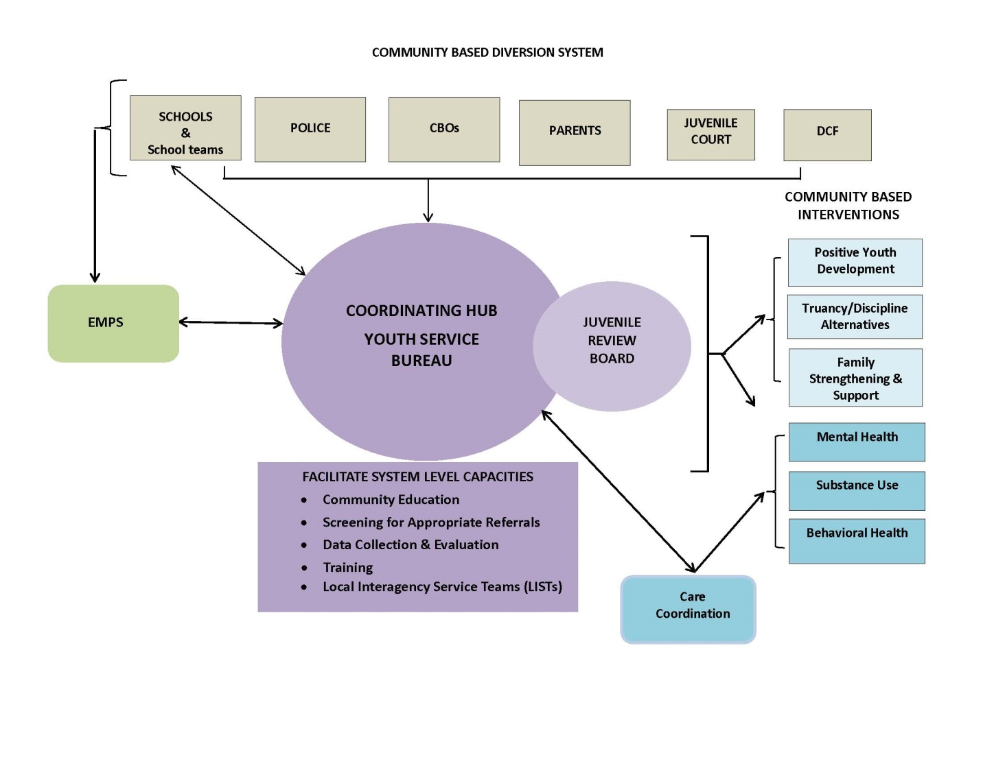
Community Based Diversion System

